Slide 1
Patient Opinion for clinical teams: exploring the issues
James Munro
Patient Opinion
james.munro@patientopinion.org.uk

Slide 3
Our mission
Service users and carers can give honest feedback safely and easily
Staff can learn from knowing how their care is experienced
Services can make small, steady improvements based on feedback
Everyone can see how services are listening to users and changing in response

Slide 4
Patient Opinion for clinicians?
Could we?
Opportunities
Obstacles
Practical issues
But should we?
Benefits
Costs
Risks

Slide 5
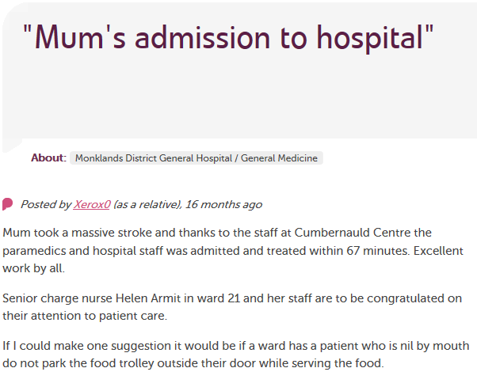
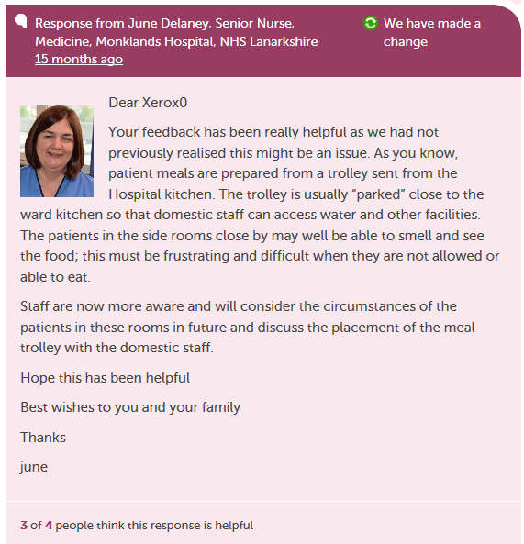

Slide 6
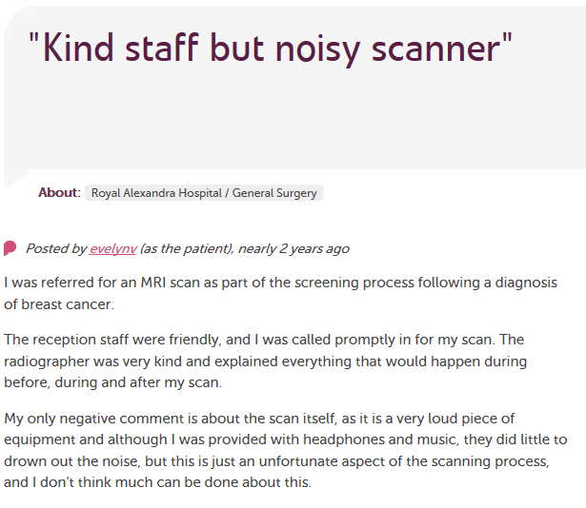
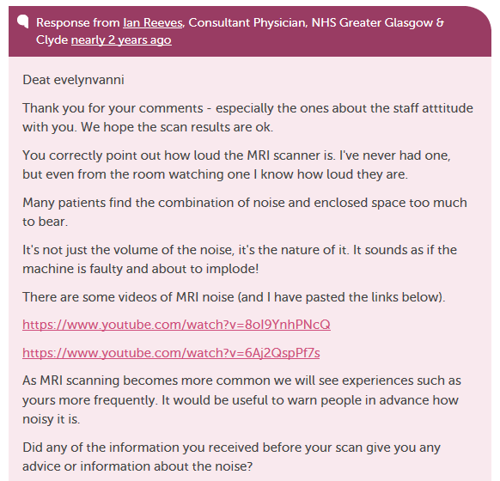
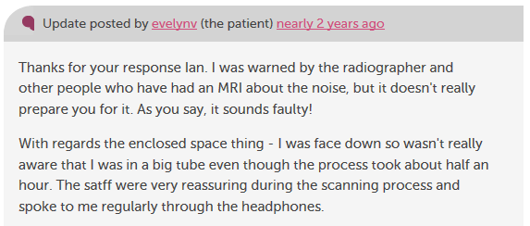

Slide 7
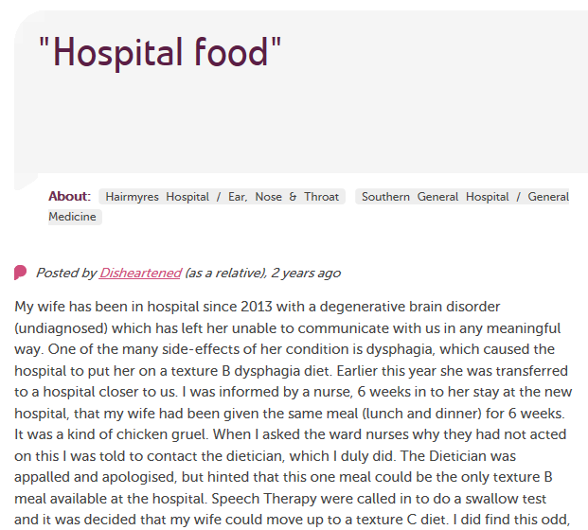
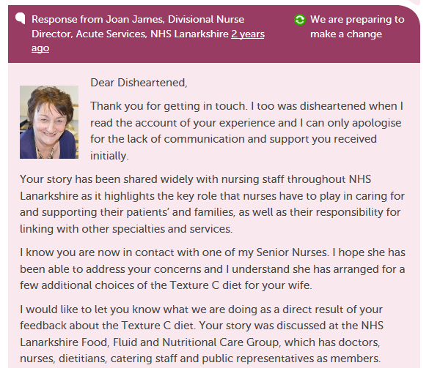
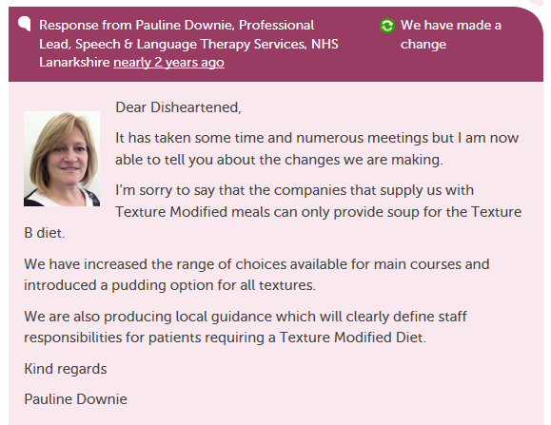

Slide 8
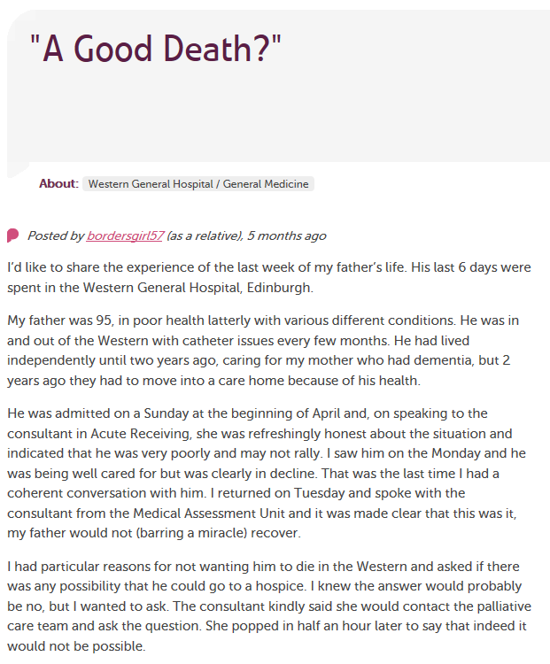
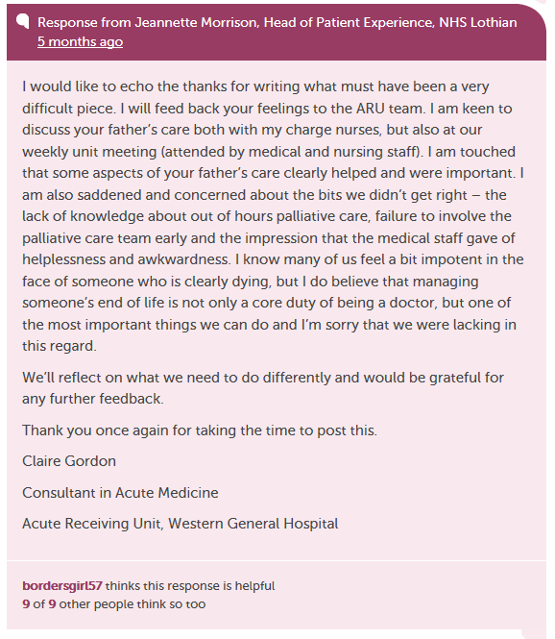
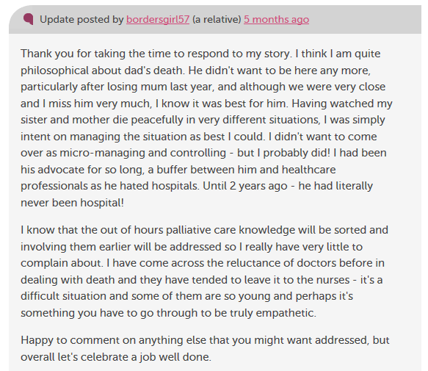

Slide 9
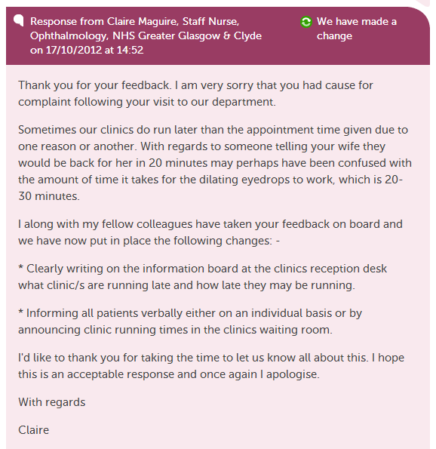

Slide 10
Staff views

Slide 11
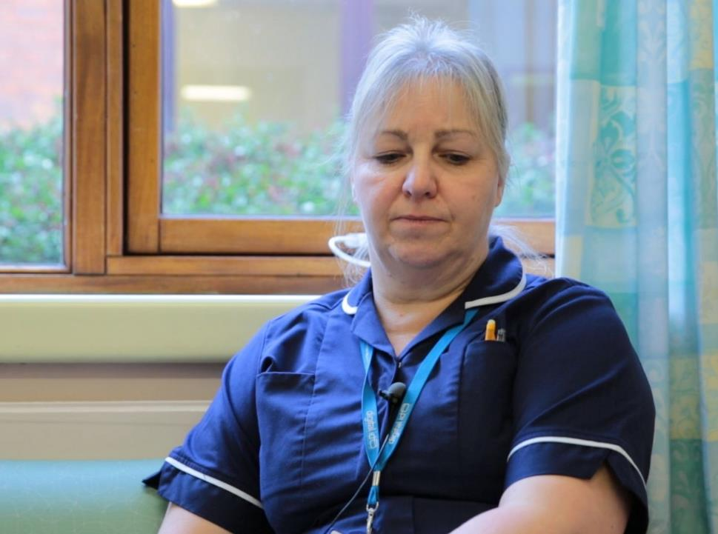
“I get an email to say we've had an opinion posted.
I can respond that day and it’s back on the website for the patient or relative to read.
I think that’s an excellent service for people.”
Karen Hansord A&E sister

Slide 12
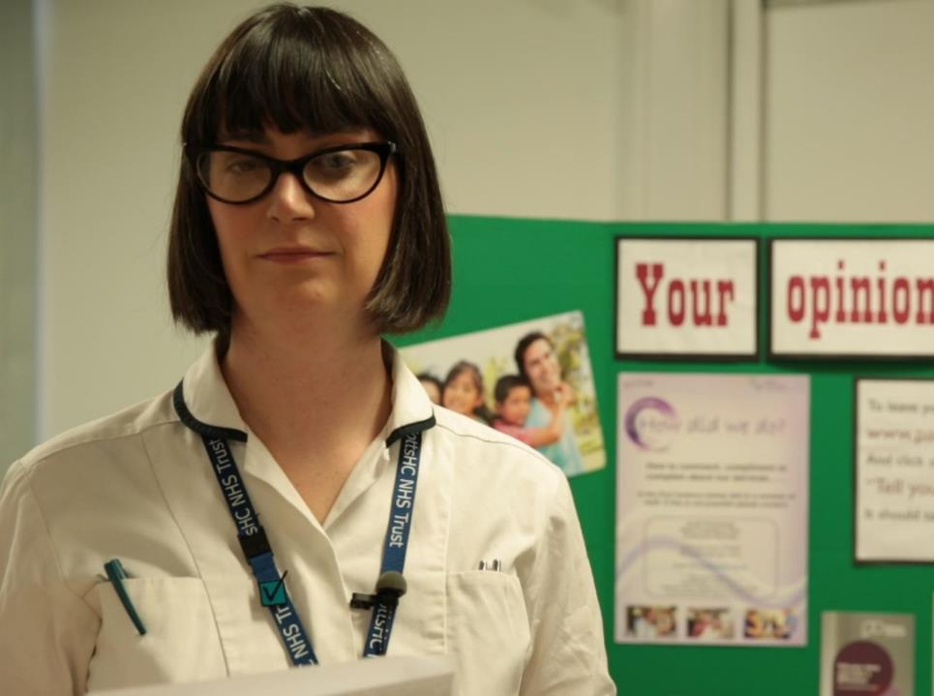
“More than just listening, it has helped us to focus on what we can change to improve our service.
We’ve learnt that Patient Opinion gives patients a powerful voice, which in turn has empowered us.”
Lisa Metcalf podiatrist

Slide 13
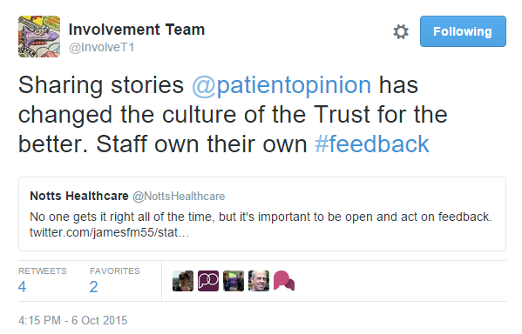

Slide 15
Learning from stories
Places the person at the centre | [Roberts 2000]
Adds richer learning and understanding | [Rugggles 2002, Charon 2009]
Engenders empathy | [Fairbairn 2002, Hardy 2007]
Encourages reflection | [Hardy 2008]
Shares perspective | [Reissman 2000]
Promotes resilience | [East et al 2010]

Slide 17
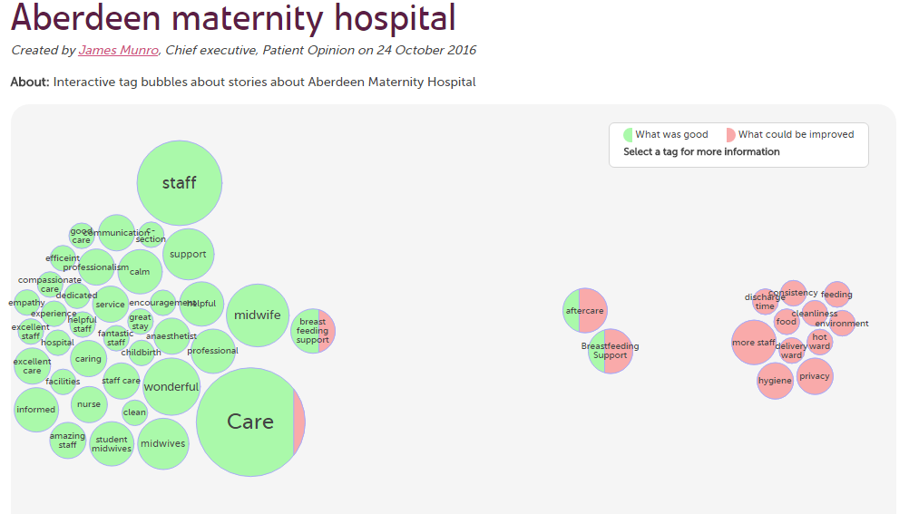

Slide 19
Patient/carer views

Slide 20
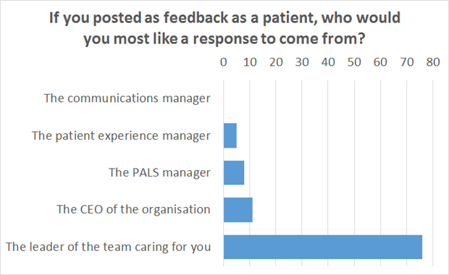

Slide 21
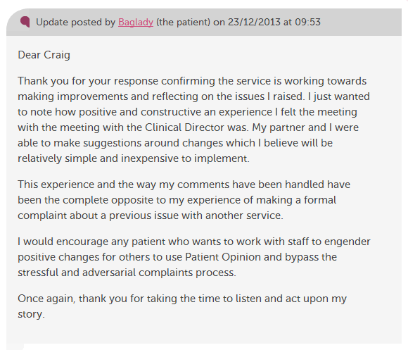

Slide 22
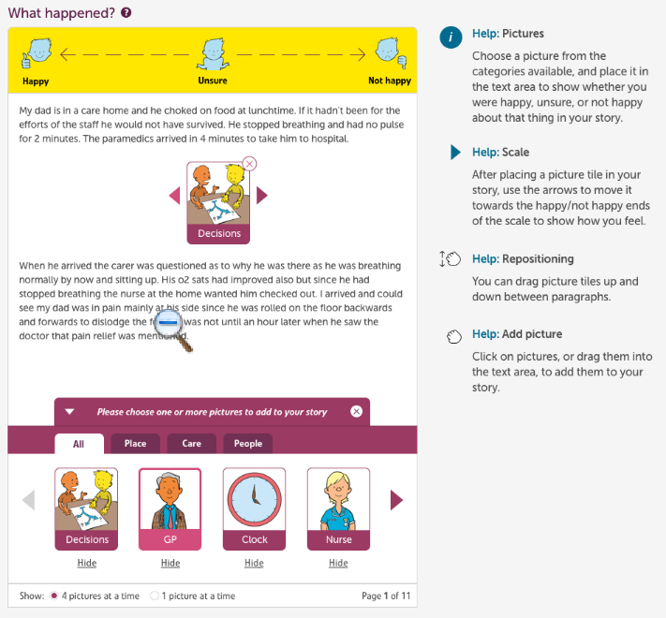

Slide 23
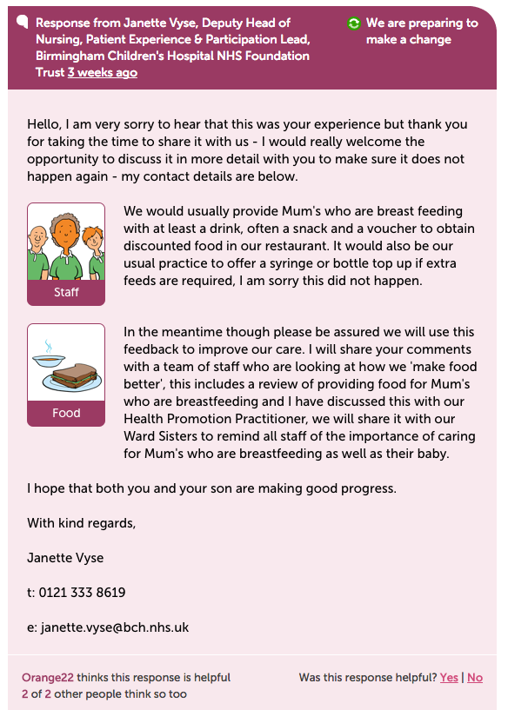

Slide 24
The world is changing – fast
Old world | New world
Hierarchy | Network
Broadcast | Conversation
Hiding | Sharing
Few | Many
Closed | Open
Passive recipients | Active participants

Slide 27
Berwick Report, August 2013
“Hear the patient voice at every level – even when that voice is a whisper”

