Slide 1
Patient involvement and engagement at St Andrew’s Healthcare
Deborah Lowe - Deputy Director of Nursing
Sophia Feurtado - Head of Patient Experience

Slide 2
St Andrew`s provides:
Specialist and secure care pathways in both mental health and neuropsychiatry, national secure services for young people, women, men and older adults.
Clinical expertise in trauma, personality disorder, psychosis, autism, learning disability, brain injury and dementia.
Criminal justice in-reach and clinical consultancy, vocational rehabilitation and outpatient care.
St Andrew`s is the UK’s leading charity providing specialist NHS care, with a reputation grown over 175 years.
We are an independent national teaching hospital, training clinical leaders for the future and research centre. St Andrew`s is partnered with King’s College London and employs over 4000 staff.

Slide 3
Our Strategy
Our new strategy sets out how we can build on our rich heritage as a charity and secure our future as a world-class provider of mental healthcare services.

Slide 5
The importance of online patient feedback at St Andrew’s
Patient Involvement Strategy - Key Focus: Patient Opinion
• Listening and responding to patients and their families
• Co-production, co-creation & co-decision making
• Supporting and communicating with carers
• Using digital technology to better engage with people
• Sharing good practice and influencing national agenda
• Involving patient and families in research opportunities

Slide 6
Activity

Slide 7
Our Story - Implementation
Executive Director of Nursing and Quality
Board leadership
Phased Soft Launch - 3 Pathways
Service Directors identified their Lead Responders
Briefings at Senior Team/Quality meetings
Developed Patient Opinion resource pack for every member of staff
Road shows/drop ins held to promote Patient Opinion and story telling sessions on the wards

Slide 8
The challenges - sceptics
“This can’t be done in secure services. I don’t see how this can work”
“It will be used by patients to have a whinge”
“What about confidentiality? We need to protect patients and staff, once information is out there, it’s out there you can’t change it”
“We will get the serial complainers and will be used as a complaints service”

Slide 9
Challenge: Limited internet access for patients
Story generation - help patients post stories
Make feedback fun – Activities and enjoyment so patients want to talk to us. (They never quite know what we will turn up with)
Travel with our laptops – so we can show people the website
Bright pink t-shirts - patients aware of who we are when we walked onto their wards

Slide 10
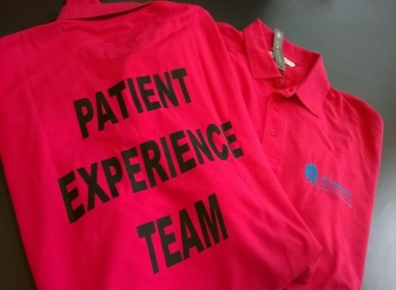
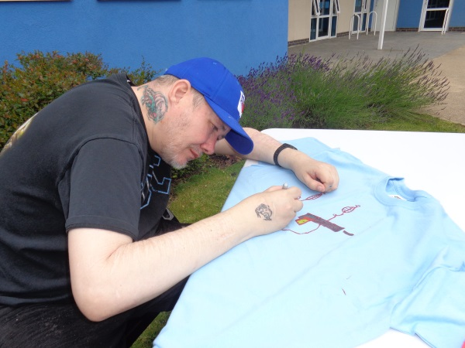
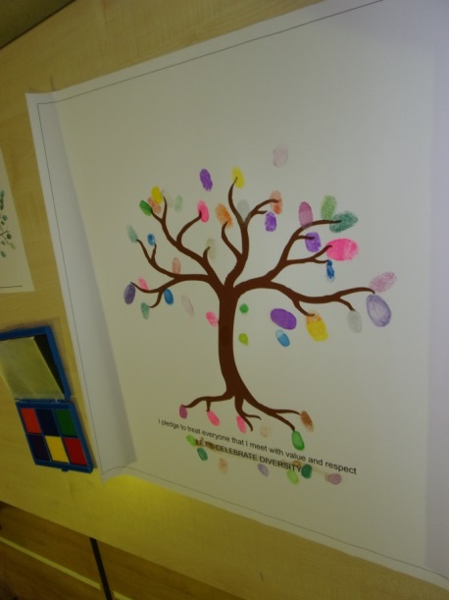
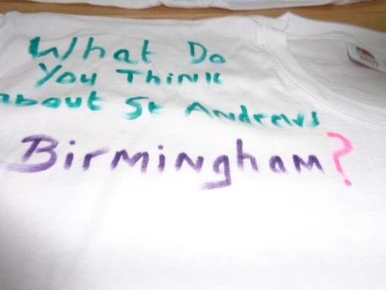
Making Feedback Fun!

Slide 11
Successes
Patients Providing feedback across pathways
Rich and diverse range of stories providing our staff with a different perspective of their services
A tool to help staff learn and act
Enjoyment - Staff were enjoying reading the stories, were learning, responding and taking immediate action. Patients enjoying participating in story telling sessions and activities.
Responses and early changes made/planned
Closing the loop – Patients see the impact of their feedback and receive personal response from staff.
Notes:
ST Andrew’s following the Triangle of Carer principles.

Slide 12
A change we made…
The Modern Matron responded:
“The ward has now ensured that Skype is accessible for all patients going forward and I hope you enjoy your skyping with your family in the future.”
Notes:
Digital tool are a supplement not a substitute for face-to-face and more traditional communication methods.
We must understand our patients before choosing tools – How do they prefer to engage ? – Involve them in designing the process.
We need to go to where the people are.

Slide 13
Vision and Future Plans Keeping the momentum going
Patient Experience Measure
Patient Experience Facilitators (patients) collecting stories
Patient Experience Leads on wards
Encourage staff to collect stories and help patients post (Advocates, Volunteers)
Patient Network – Patient Opinion widget on patient intranet
Share the stories and learning more widely (notice boards, intranet, story books, community meetings, team meetings)
Wider launch with carers, families and friends
Ongoing transparency in relation to feedback.
Notes:
Digital tool are a supplement not a substitute for face-to-face and more traditional communication methods.
We must understand our patients before choosing tools – How do they prefer to engage ? – Involve them in designing the process.
We need to go to where the people are.

Slide 14
Thankyou and questions
Further information can be obtained from:
Sophia Feurtado
Head of Patient Experience
safeurtado@standrew.co.uk
01604 61 6515

