Slide 1
- the ULHT Way
Sharon Kidd
Patient Experience Manager

Slide 2
The ULHT Patient Opinion journey since 2011
Background
Exemplar trust status
Friends & Family Test
Monkey Wellbeing & Patient Opinion project

Slide 3
So why do we use Patient Opinion?
A full reporting suite
Multiple responses can be posted
Build up a relationship with the person posting the story
Ability to pull stories from NHS Choices so stories for ULHT are centralised
Trust has dedicated team to assist with issues and concerns
Time to respond to concerns – within 24 hours
Independent of the NHS
Ability to blog about working being undertaken in the trust

Slide 4
A CEO’s perspective

Slide 5
How we manage
Board sign up - CEO and Chief Nurse receive all story notifications
Patient Opinion web pages
Patient Opinion stories are recorded in Datix
Patient Opinion data reported to Board
Patient Opinion logo now on website footer

Slide 6
How we use Patient Opinion stories
Patient Opinion data reported to Board each month
Staff engagement

Slide 7
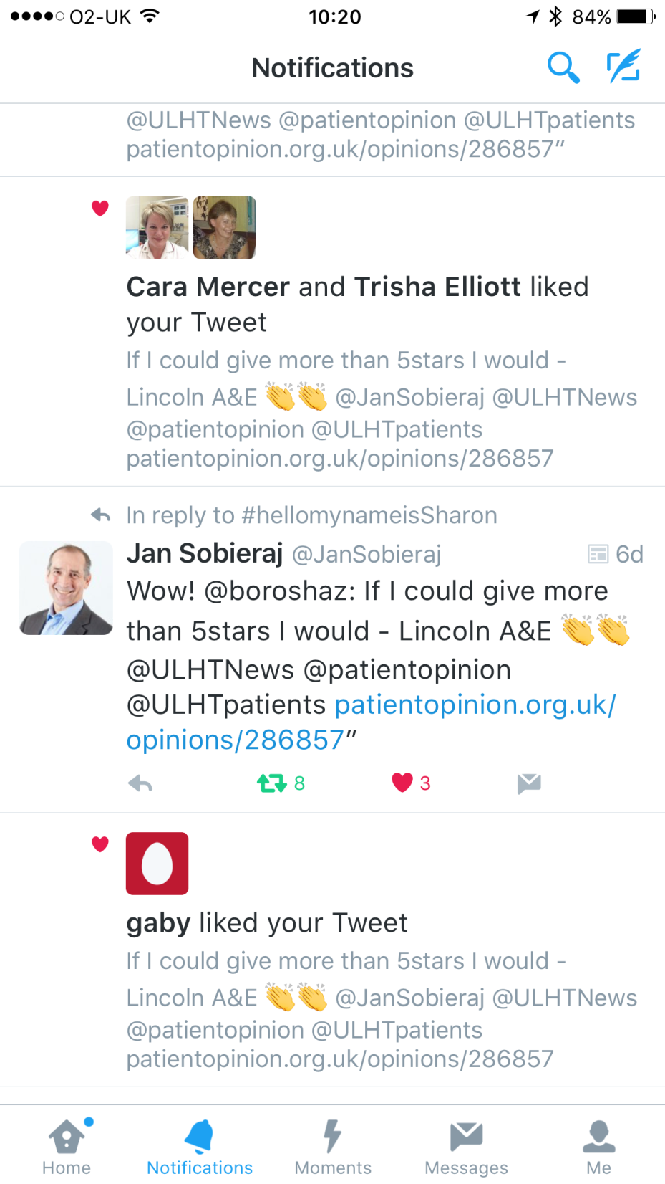
Patient Opinion and social media
Positive patient stories have a great impact on staff morale, especially when we read/hear negative things. It’s the only place we can escape from it
ULHT Together Facebook
Launched December 2015
Currently 3,895 members of staff from 7,500
Post positive stories only
Twitter
I thinks it’s a great way to share positive feedback, a real morale boost. We can all check the Patient Opinion site – patients included and negative feedback should be communicated through ward meetings
I like to see the positive stories. However I don’t feel this is the right forum for negative feedback
Notes:
Site launched to welcome international nurses to offer them supoprt. Idea has grown and not just nurses. Allows staff to share ideas, ask questions provide help

Slide 8
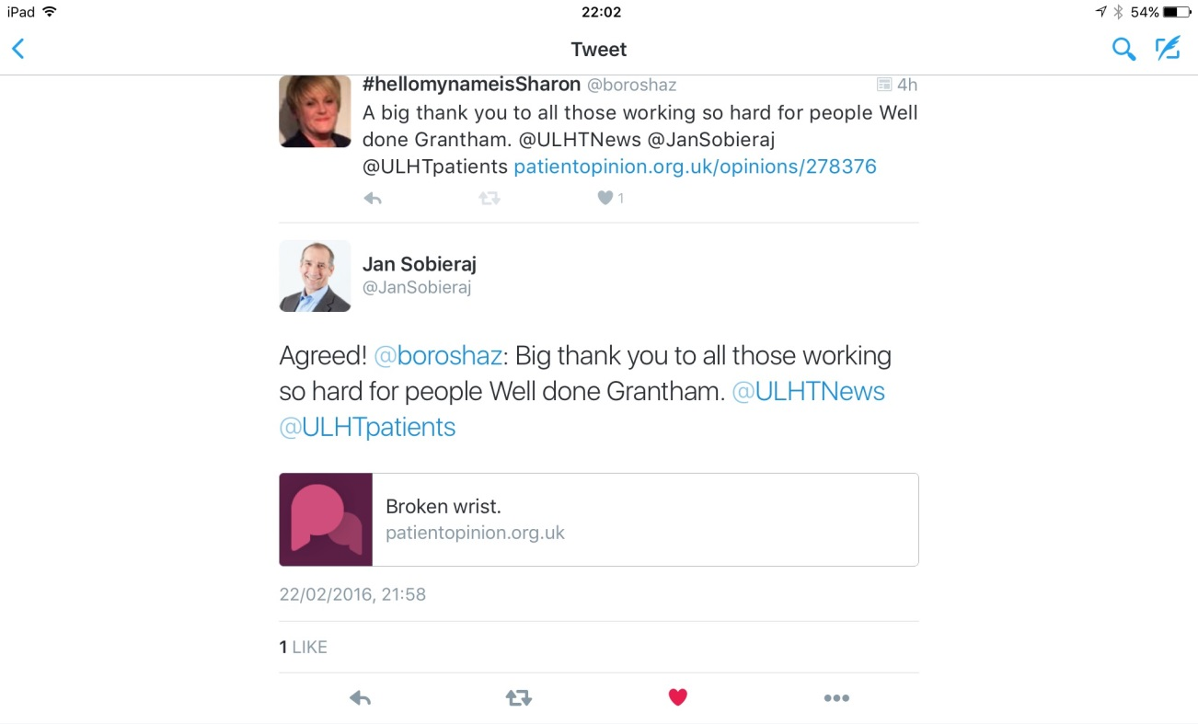
Patient Opinion and social media
Twitter

Slide 9
Seeking feedback directly from our youngest patients
Sharon Kidd
Patient Experience Manager

Slide 10
Seeking feedback from children
National CYP survey
Friends & Family Test

Slide 11
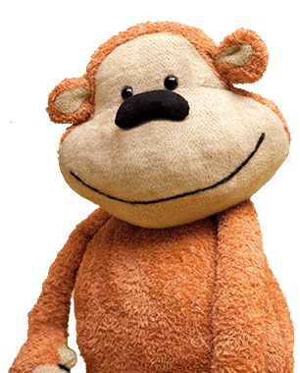
Monkey Wellbeing
What is Monkey Wellbeing?
Notes:
Patient Opinion is about honest and meaningful conversations between patients and health services. We believe that your story can help make health services better.
This service helps busy organisations to use real time feedback to have a genuine impact on their services. We help make sense of the feedback and data, giving your busy staff a simple way to make cost-effective, measurable improvements – that are visible to everyone!
Hi, I’m Helen Sadler… Josephine’s mummy.
Monkey has done a great job in telling you our story, but there are some details I’d like to share with you in my own words.
When my husband, Daniel, and I found out we were expecting Josephine, our first child, we were overjoyed. But at the 20-week scan we were presented with the daunting news that our unborn baby had CCAM, a rare cystic lung complaint, and would have to undergo major surgery when she reached 18 months old.
She was born in August 2007, and 18 months flew by. As surgery loomed, we were determined she wouldn’t feel anxious and searched for storybooks to help her through the whole experience.
We found illustrated stories, but nothing that would give her a real sense of what she was about to experience. So I took action. As a primary school teacher I used my skills to create a handmade book. The idea was simple, a toy monkey was the patient and he was photographed in the actual hospital rooms that Josephine would visit, with the equipment that she would see all around her.
It paid off, Josephine was relaxed and positive. She was excited when she recognised the machines and people that monkey had introduced her to. Her positive spirit throughout her stay helped to relieve everyone’s worry – and boost her recovery.
The pioneering keyhole surgery at The Royal Alexandra Children’s Hospital in Brighton was successful and Josephine’s rate of recovery was much quicker than expected. The feedback from the hospital was that they wanted more. So I set to work… and the Monkey goes to Hospital storybook was born. The Royal Alex quickly commissioned a second edition of Monkey has an Operation, followed by Monkey has a Blood Test.

Slide 12
A fresh approach..
Patient Opinion & Monkey Wellbeing pilot
4 trusts in pilot
Dedicated child friendly safe & innovative website
Stories directly from CYP
Increase real-time feedback
Allow voice of CYP in service improvement
Feedback responded to publically

Slide 13
Monkey Patient Opinion website
https://www.patientopinion.org.uk/monkey

Slide 14
Video

Slide 15
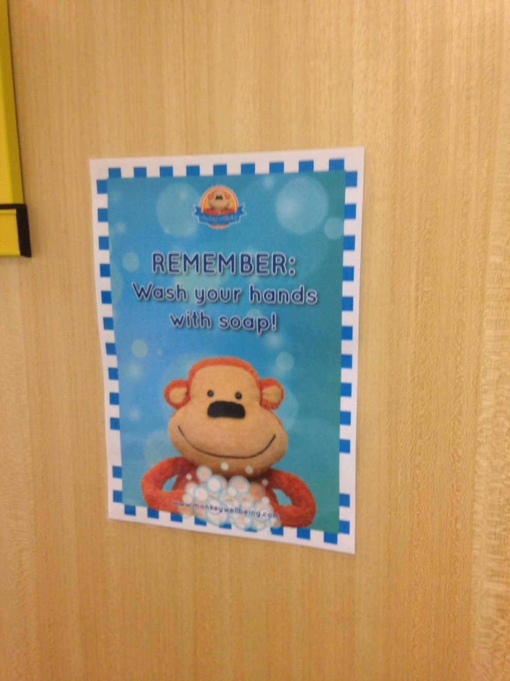
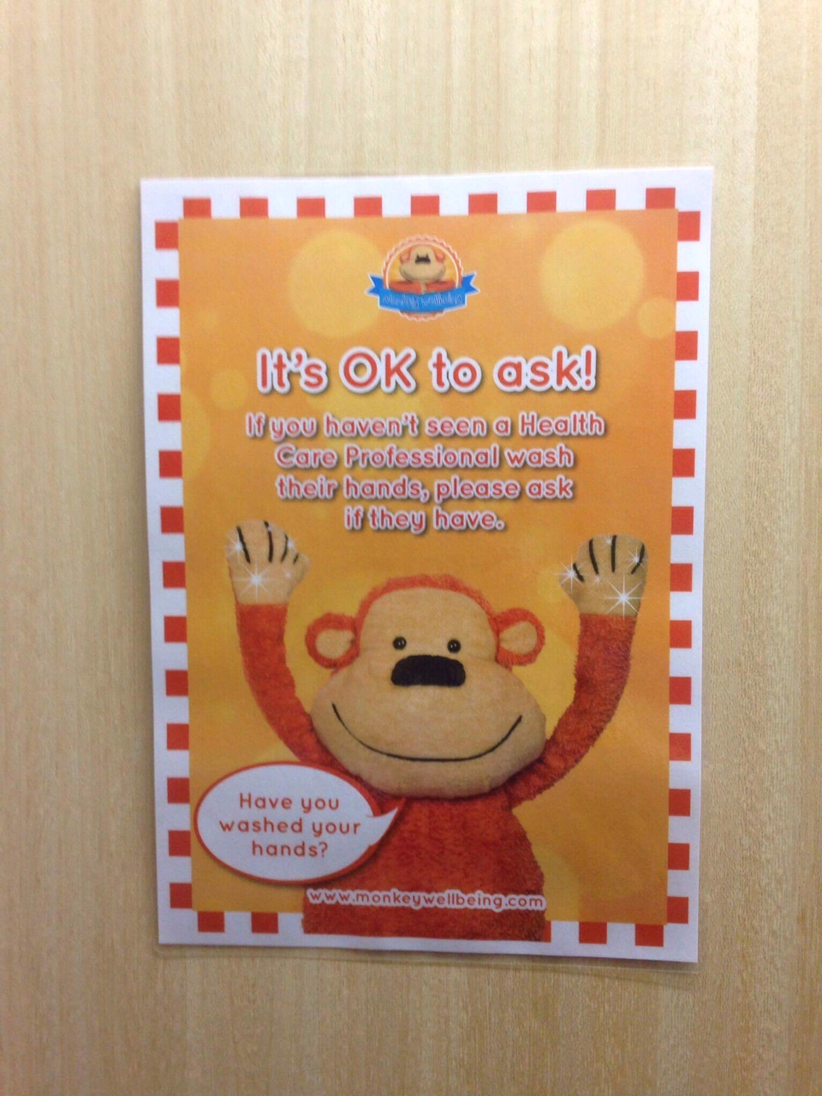
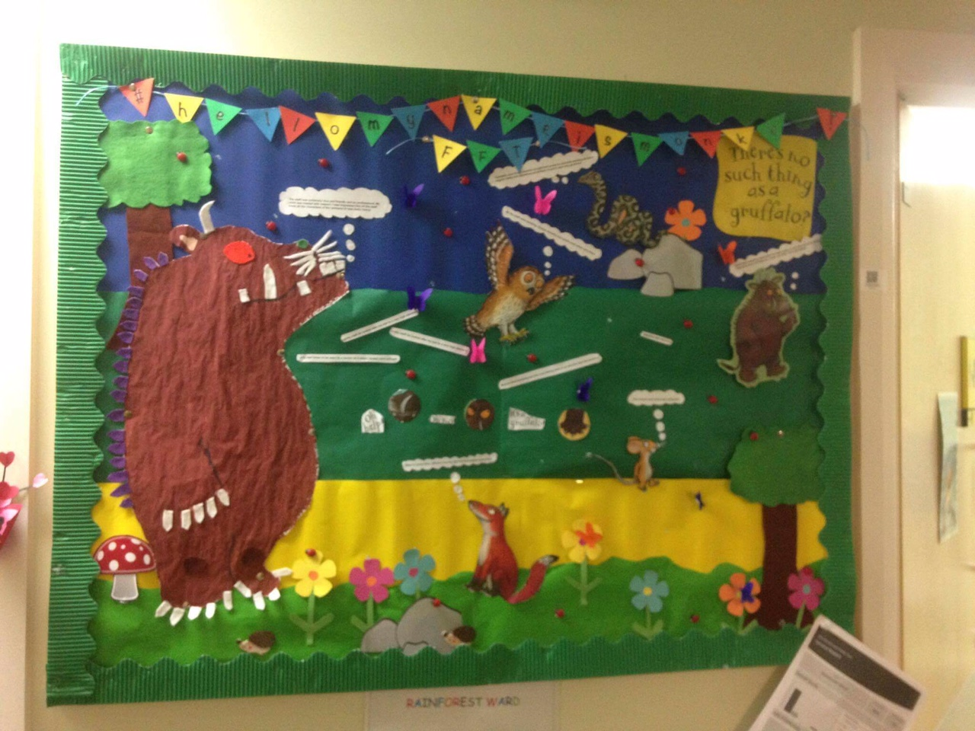
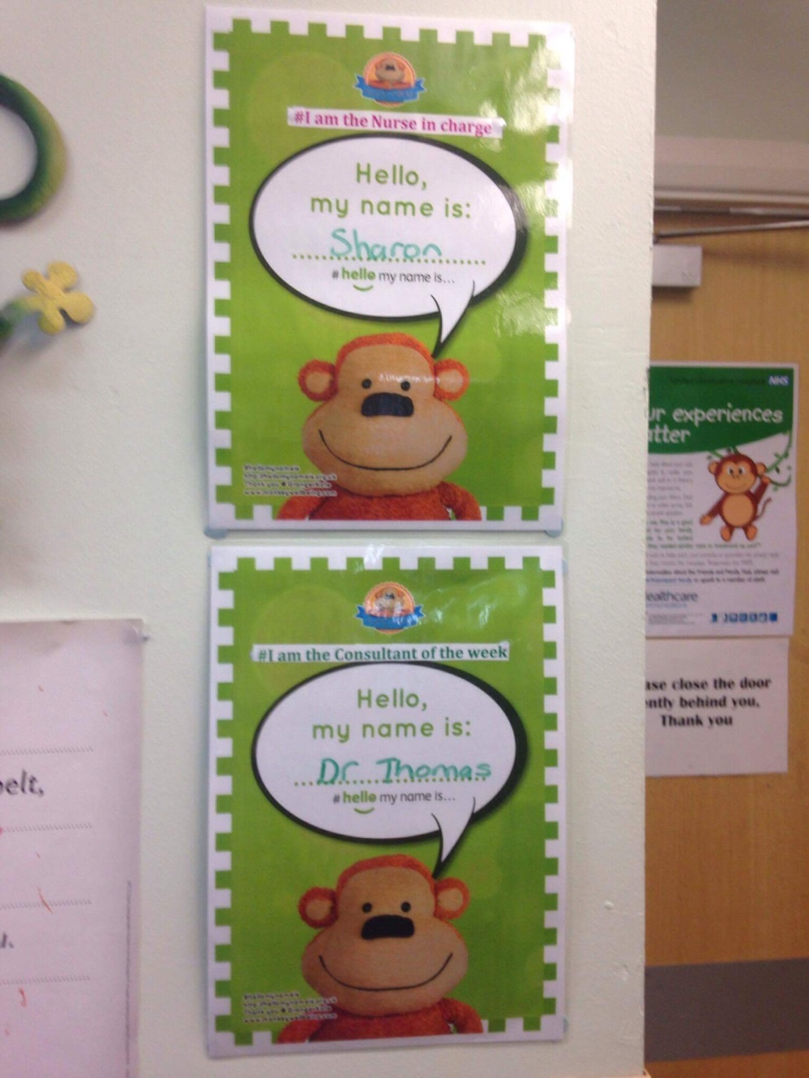
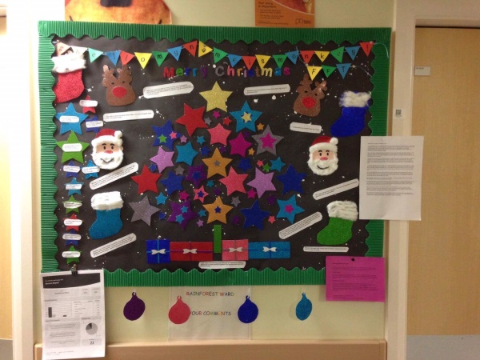
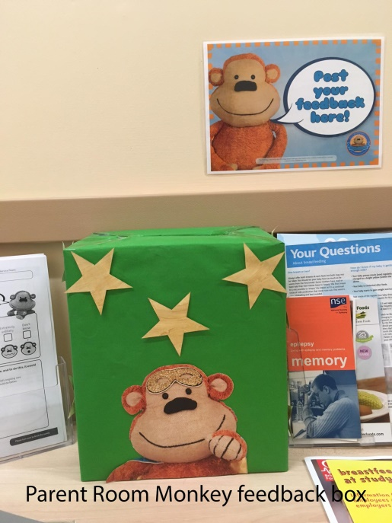
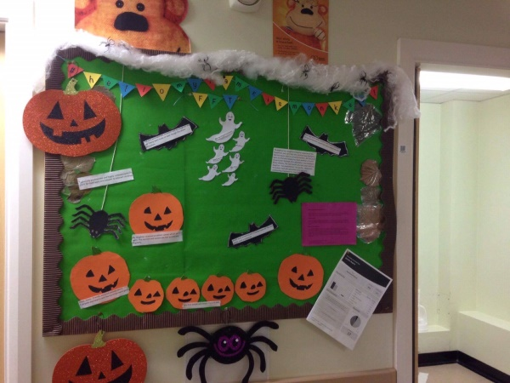
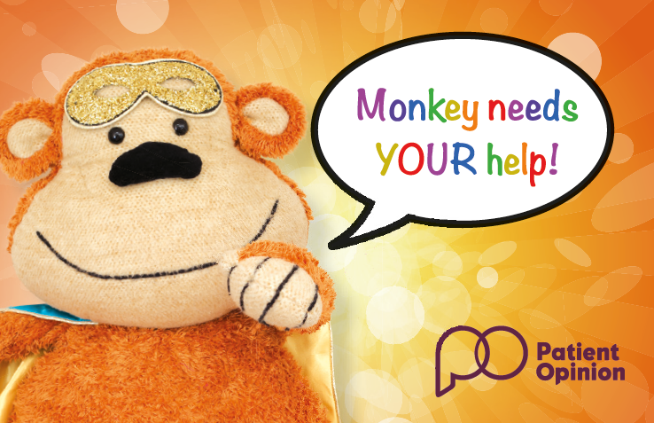
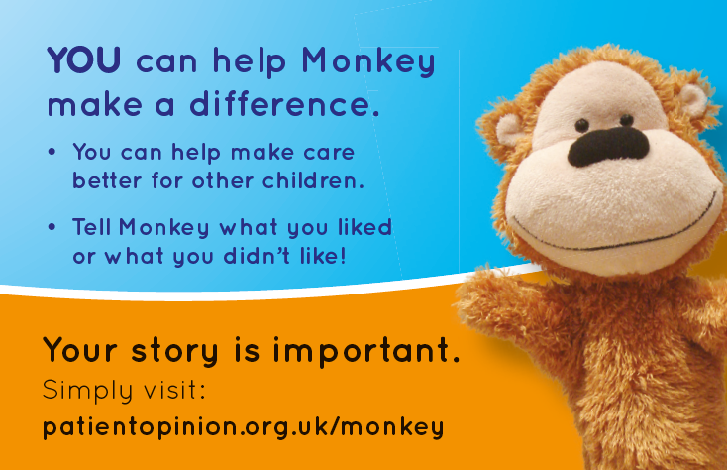
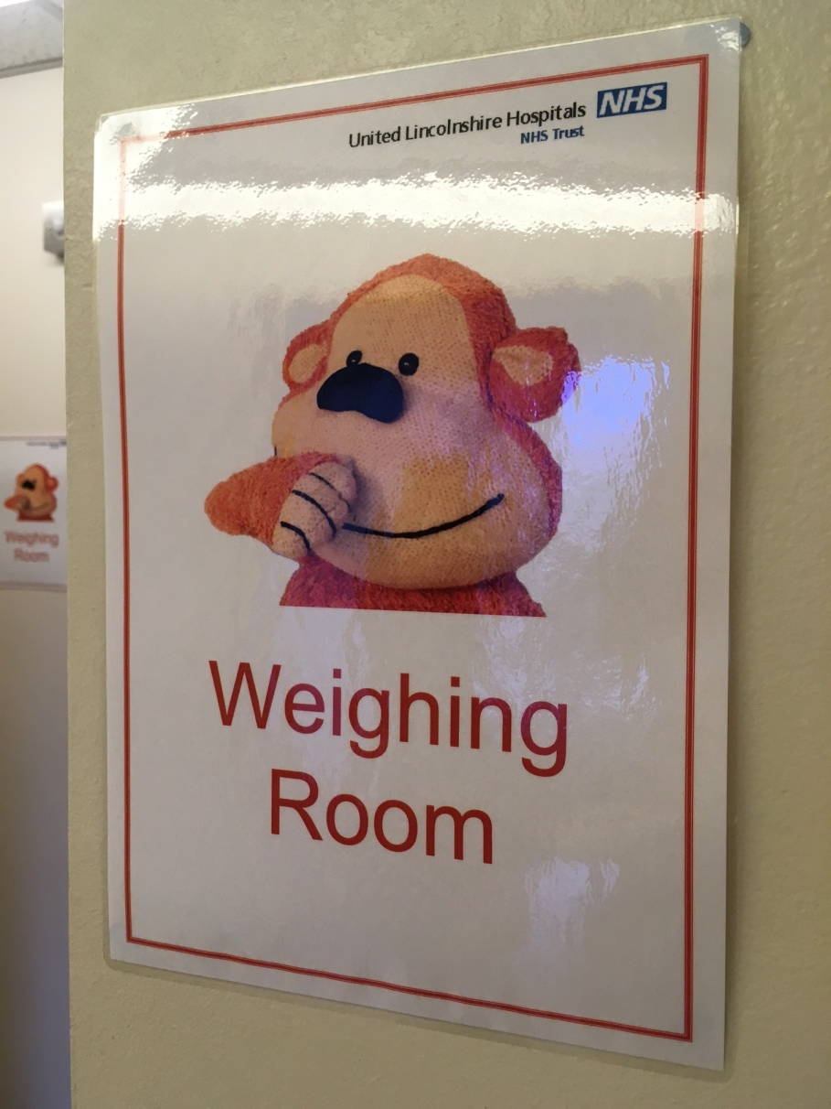
So how does it work?
Ward decorations
Parent room feedback box
Monkey feedback cards
Monkey feedback wall
You said….we did

Slide 16
Feedback

Slide 17
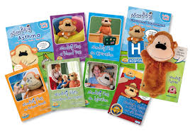
Next steps……
Proactively roll out to all paediatric areas
Order Monkey booklets
Ward information placemats, uniform poster and ward board
Publish project on NHS Academy of FAB stuff

Slide 18
Sharon Kidd
Patient Experience Manager
Sharon.kidd@ulh.nhs.uk
@boroshaz
@ULHTpatients

