Slide 1
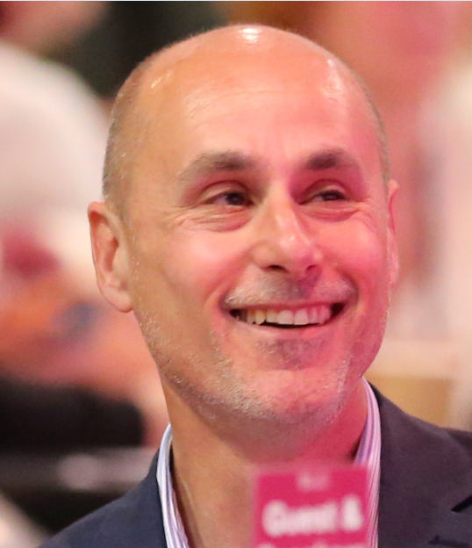
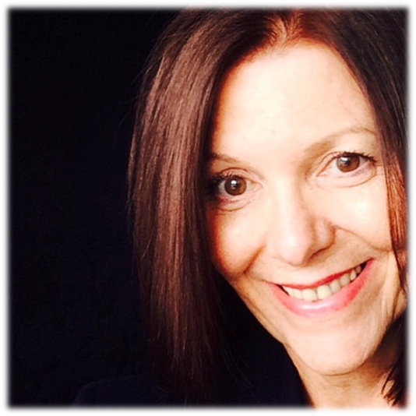
Patient Opinion in mental health care Continuing the journey…
Paul Sanguinazzi
Jane Danforth
Head of Involvement & Experience
Involvement & Experience Officer

Slide 2

Notes:
Culture and the journey of the Trust 2008-2017
Post Francis
Shifting the culture, open, responsive and focused on service change
Patient Opinion. How does it make a difference?
Stories engage and capture patient experience in a different way to surveys which still provide us with a breadth of feedback but greater choice in how to leave feedback is increasingly popular.

Slide 3
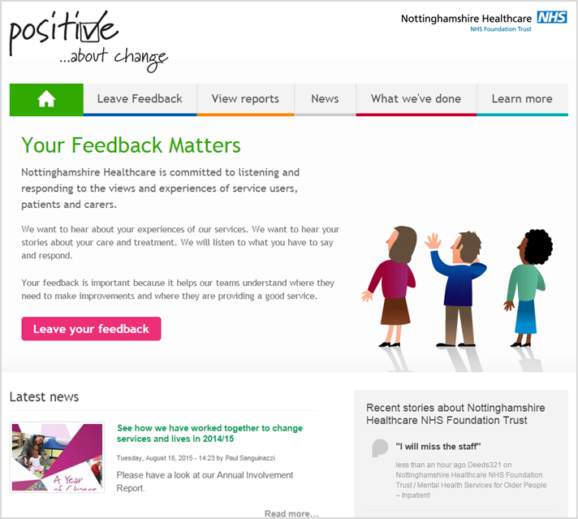
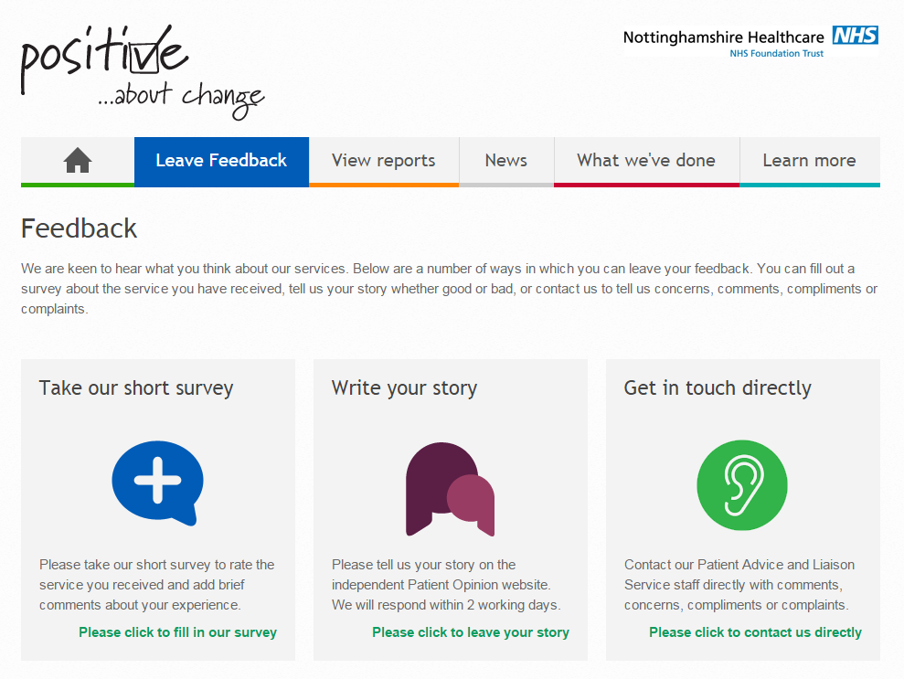
Openess Our Patient Experience Website
http://feedback.nottinghamshirehealthcare.nhs.uk
Notes:
Openess: All our feedback is visible and accessible
Listening and responding to feedback .
Stories on PO have been shared thousands of times and changes have been made as a result

Slide 4

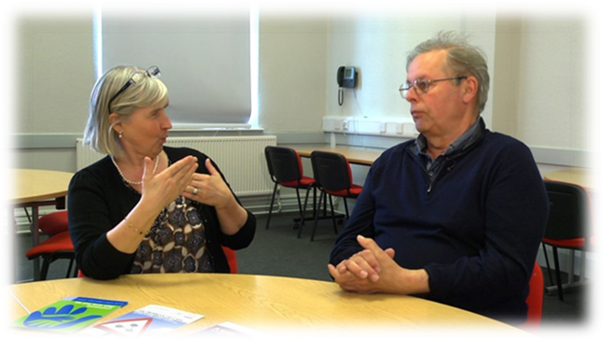
Listening
Notes:
Active Listening - staff empathy
Being honest
No corporate responses - individual and focused on the author

Slide 5
Engaging Staff
‘’We have run out of superlatives to describe the work that Vicky does for Rowan 1 and Rowan 2. She does a superb job to a very high standard- I will be sure to pass on your feedback, which I'm sure she will be very appreciative of.’’
‘’Having just recently transferred to this ward, I have to say the care and professionalism shown to my family member has in my opinion been nothing short of appalling’’ - Thurland Ward
Notes:
Numbers on PO activity, knowing who reads the stories
Engaging staff
What happens and how
Vexatious posting

Slide 6
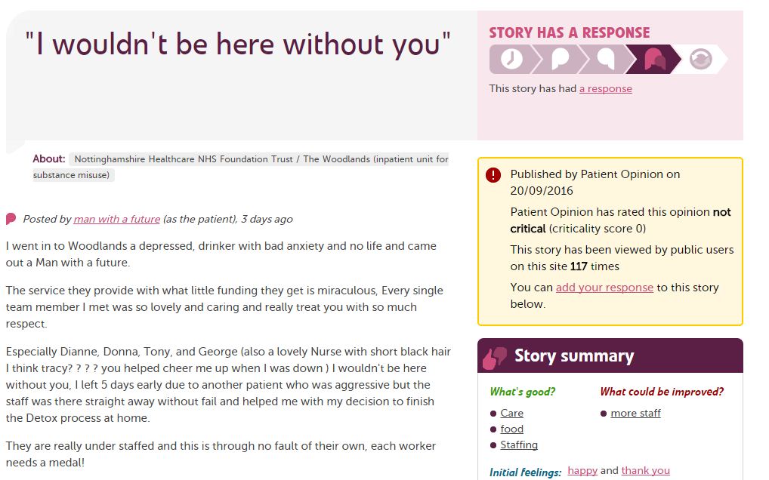
Positive Feedback

Slide 7


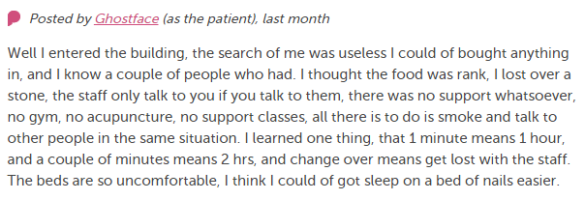

Responding to Negative Feedback

Slide 8
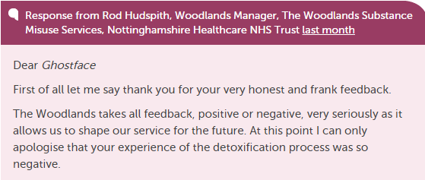
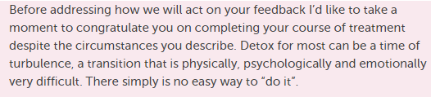
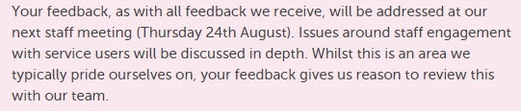
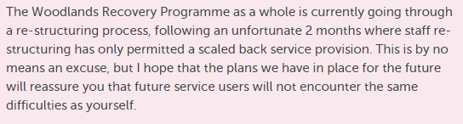
1 Apology & Thanks
2 Positive acknowledgment
3 Discussion
4 Explanation not excuses

Slide 9
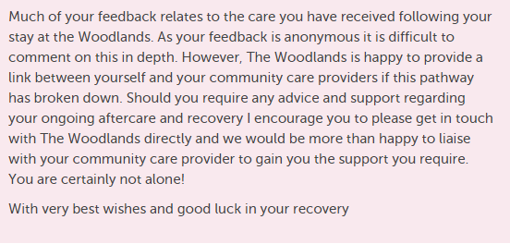
5 Follow Up & Offer of Support

Slide 10
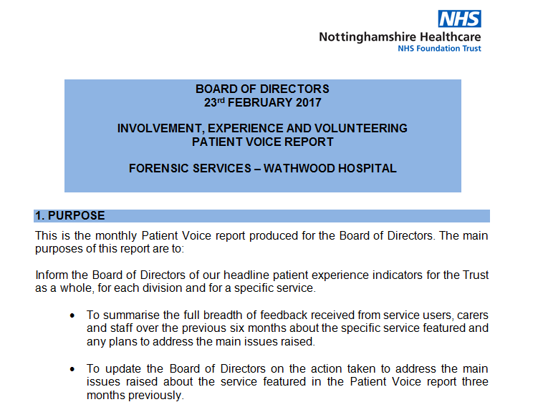
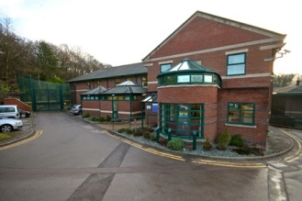
Changes
Notes:
The power of Patient Opinion to help improve services and lives
Staff are trusted to capture and act on feedback.
Teams own their own feedback
Staff are empowered
Embedded in training L & D etc.
The Involvement Team and the Trust board re-visit reports every three months and a year on with an update

Slide 11
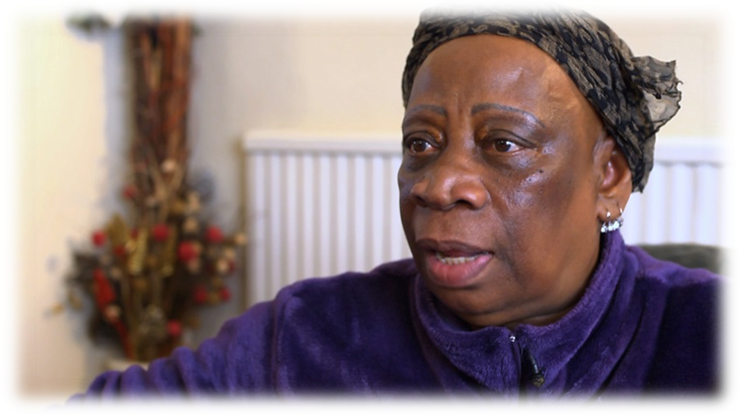
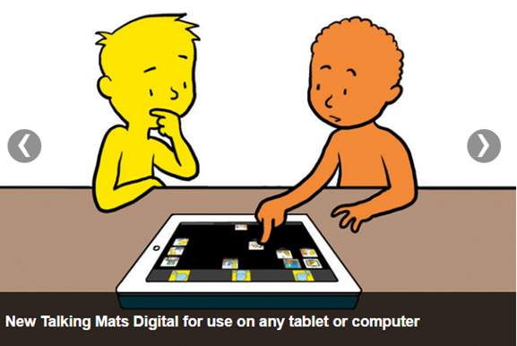
The Future
Trust Commitment in times of austerity
Making feedback visible and accessible
Focused feedback for service change
Volunteer feedback collectors
Technology
Notes:
Next three years
Themed feedback wards community etc
Tech helping us to achieve change e.g. Change trigger alerts on PO

Slide 12
