Slide 1

Care Opinion:-
An Overview
Jane Rowlands-Mellor: Lead Nurse Patient Experience
Tel: 029 20744904

Slide 2
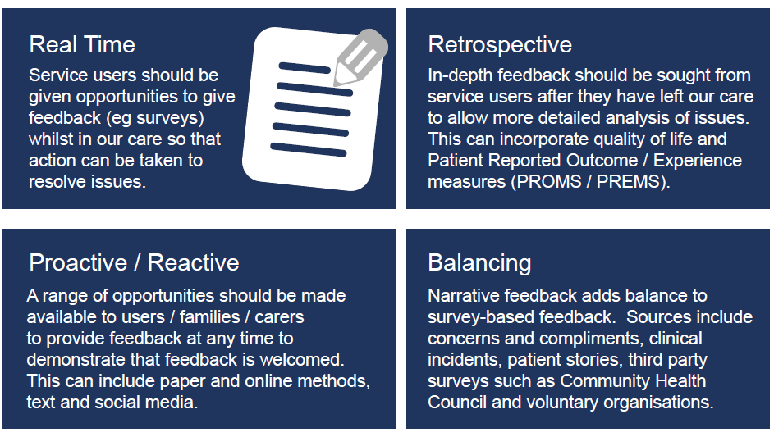

Welsh Government Framework for Assuring Service User Experience 2015

Slide 3
A Care Opinion Post: the Process
Email alert received from Care Opinion
Ascertain most appropriate contact to assist with a
response
Response provided
On occasion further responses required

Slide 4
Providing the Response
Contact the Director of Nursing for the particular
Clinical Board or a senior relevant colleague
Guidance available if required by Care Opinion
Colleagues often find it difficult as the post is often
anonymous

Slide 5
Variety of Posts
Cardiology –waiting times for surgery
Neurology –waiting times to be seen
Emergency Unit – daughters care
Ophthalmology Clinic –staff kindness
Department of Sexual Health –appointment process
Mental Health – positive support –incorrect literature
Themes and Trends
Often great variation
Staff and service compliments

Slide 6
Outcomes
Cardiology – follow up post thanking the Sister on
C3 who had contacted the lady within an hour of her
original post
Ophthalmology - little gestures of kindness -grateful
that this was shared with the relevant staff

Slide 7

Raising Awareness of Care Opinion
Discuss at patient experience training and education
sessions
Incorporate in ‘How are we doing?’ leaflet
Raise awareness via the UHB
Communication Team

Slide 8

Thank you for listening

