Slide 1
people helping health/care get better
james.munro@careopinion.org.uk
@jamesfm55
@careopinion

Slide 2
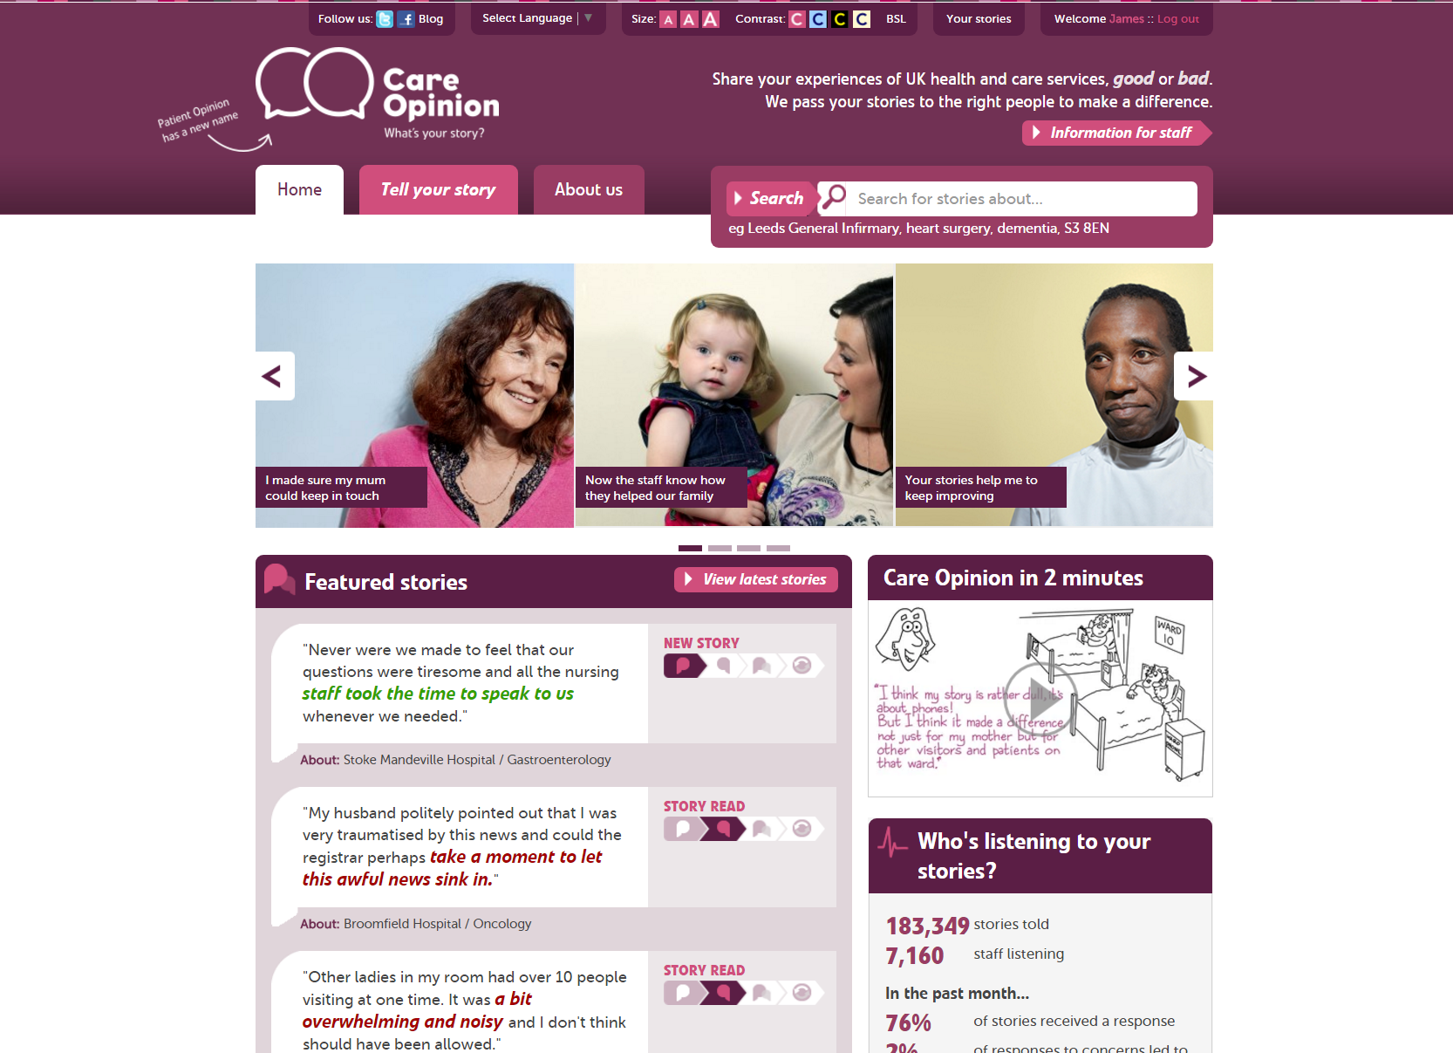

Slide 3
Vision
We want people to be able to share their experiences of health and care in ways which are safe, simple, and lead to learning and change.

Slide 4
Mission
Our mission is to provide an online platform so that:
people can share honest feedback easily and without fear
stories are directed to wherever they can help make a difference, and
everyone can see how and where services are listening and changing in response

Slide 5
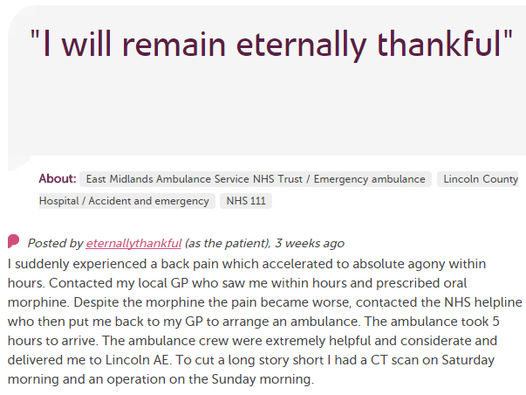
In each provider
Moderation
Clinical staff
Porters, reception, catering…
Pt exp, comms, complaints…
Alerting
CEO
Health boards
Nursing, AHP students
HSCPs
Researchers
Patient groups
HIS
Local authority

Slide 6
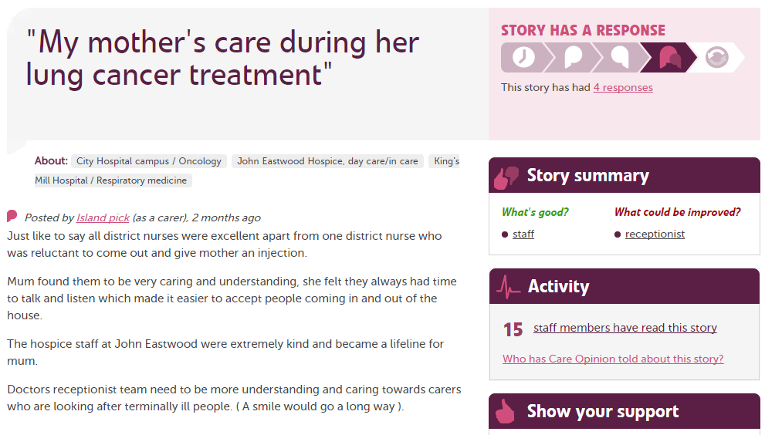

Slide 7
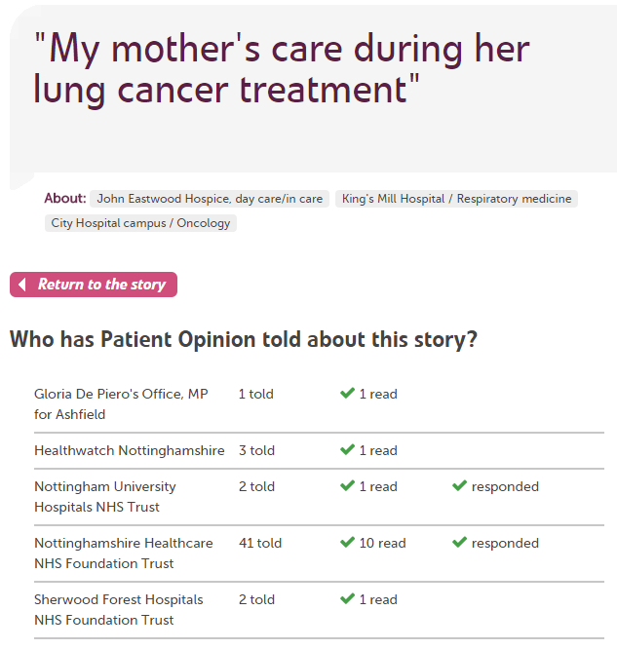
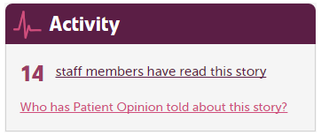

Slide 8
180,000
stories
7,000
staff + students listening
stories read
85 million
times
100,000
visitors per week

Slide 9
Lots of activity. But for what benefit?

Slide 10
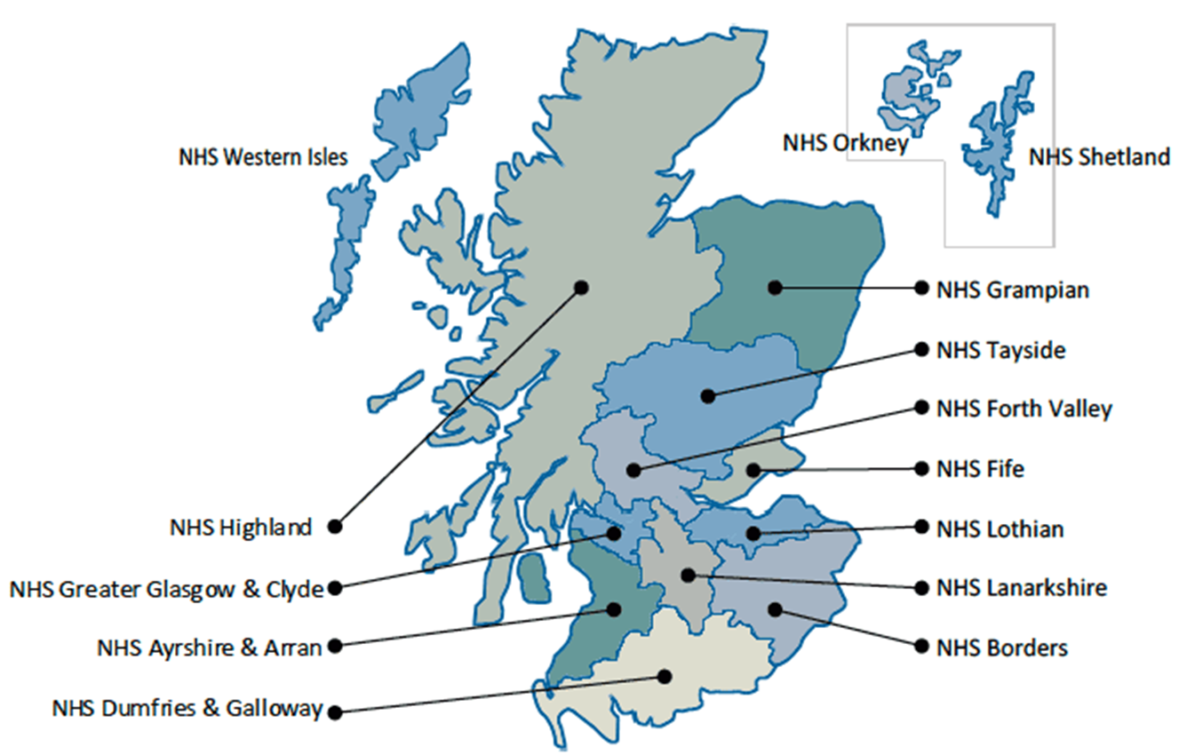
Care Opinion in Scotland
All territorial health board
Scotland wide services
Scottish Ambulance Service
NHS 24
Golden Jubilee National Hospital
National Services
Healthcare Improvement Scotland
NHS Education for Scotland
NHS National Services Scotland
The State Hospital

Slide 11
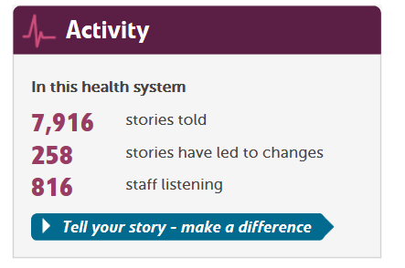
NHS Scotland

Slide 12
NHS Wales

Slide 13
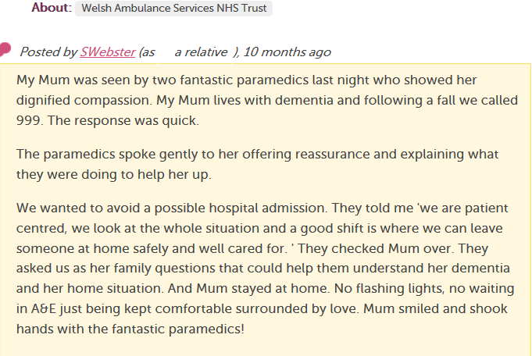
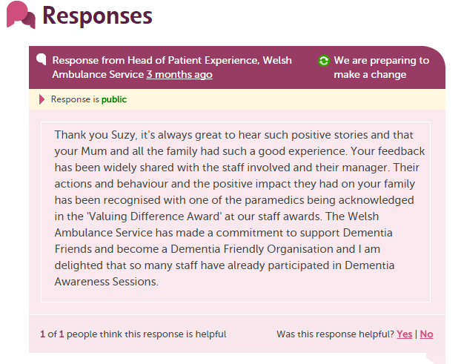
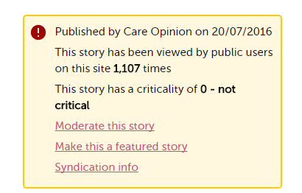

Slide 14
Patient Experience White Paper
“Listening‟ must be a planned activity, built into the structures of NHS Wales organisations to ensure it happens
Listening to patient experiences relating to first and lasting impressions can reveal areas where changes can be made that will matter to patients
Organisations exhibiting a genuine willingness to listen will be in a position to provide better care to their patients and will identify ways to improve more quickly.

Slide 15
Care Opinion

Slide 16
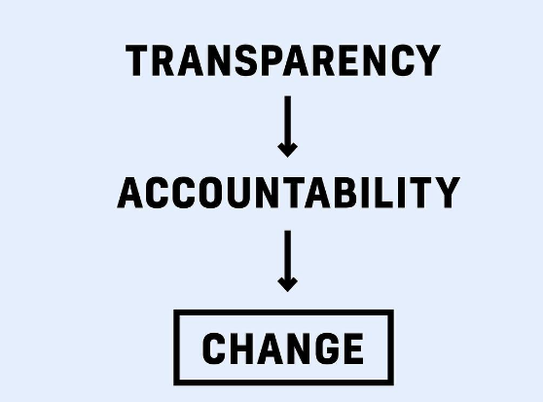

Slide 17
Patient Opinion in Wales
Meetings and Discussion at all levels
Most HBs registered on no cost level
Proposals to work with different HBs
Plenty of interest from HB staff
One third sector subscription
760 Stories with little promotion.

Slide 18
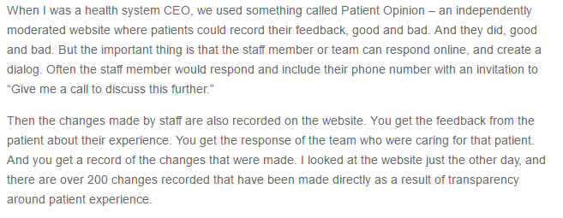
Facing the Fear of Transparency October 2016
Derek Feeley
President/CEO, IHI
(formerly CE/DG of NHSScotland)

Slide 19
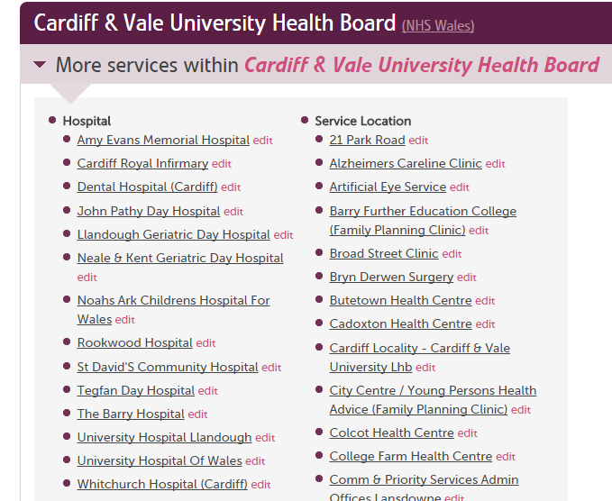

Slide 20
Berwick Report, August 2013
Recommendation 8
“All organisations should seek out the patient and carer voice as an essential asset in monitoring the safety and quality of care.”

Slide 21
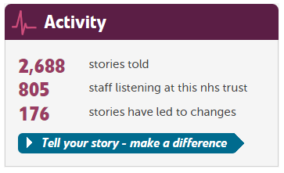

Slide 22
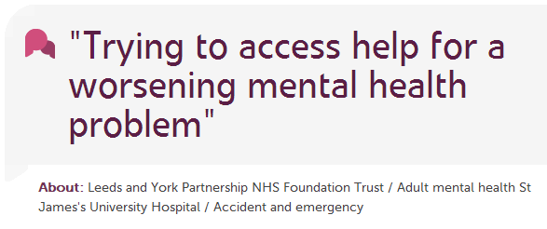
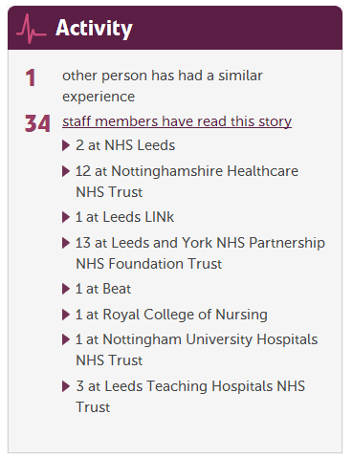

Slide 23
How stories improve integration across health and social care
Care Home
“The ambulance arrived quickly”
Daughter
Ambulance
Local NHS hospital
Ambulance
“We really liked the step down home
but it was awful arriving there at 22.00
after waiting all day for the hospital to
discharge her”
Daughter
Step down facility
Ambulance
Social care
Care Provider
Health services
“We used to find residents coming
back to us late at night so it was great to
see the new arrangements working”
Care home comment
Community physio

Slide 24
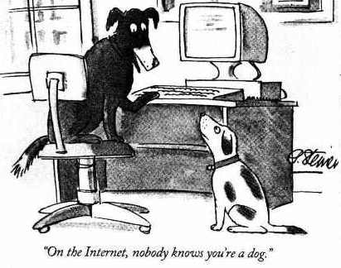

Slide 25
