Slide 1
What are the outcomes of online feedback?
James Munro
Patient Opinion
james.munro@patientopinion.org.uk

Slide 2
For authors

Slide 3
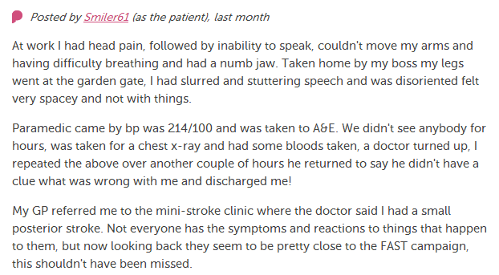
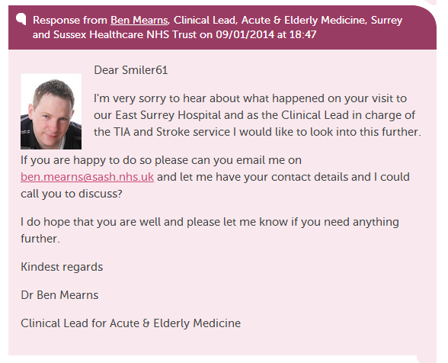
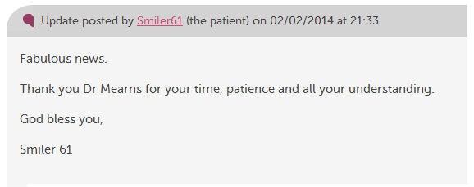

Slide 4
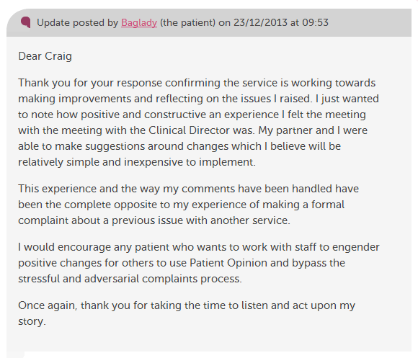

Slide 5
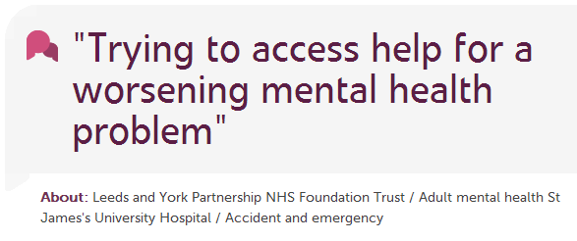

Slide 6
For staff

Slide 7
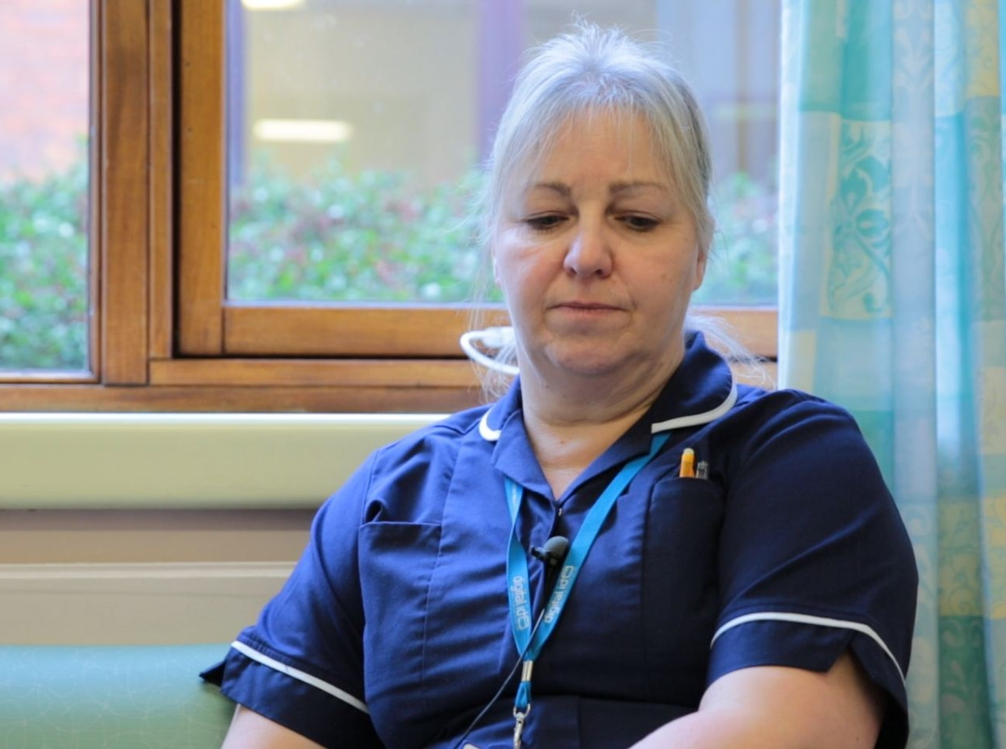
“I get an email to say we've had an opinion posted.
I can respond that day and it’s back on the website for the patient or relative to read.
I think that’s an excellent service for people.”
Karen Hansord A&E sister

Slide 8
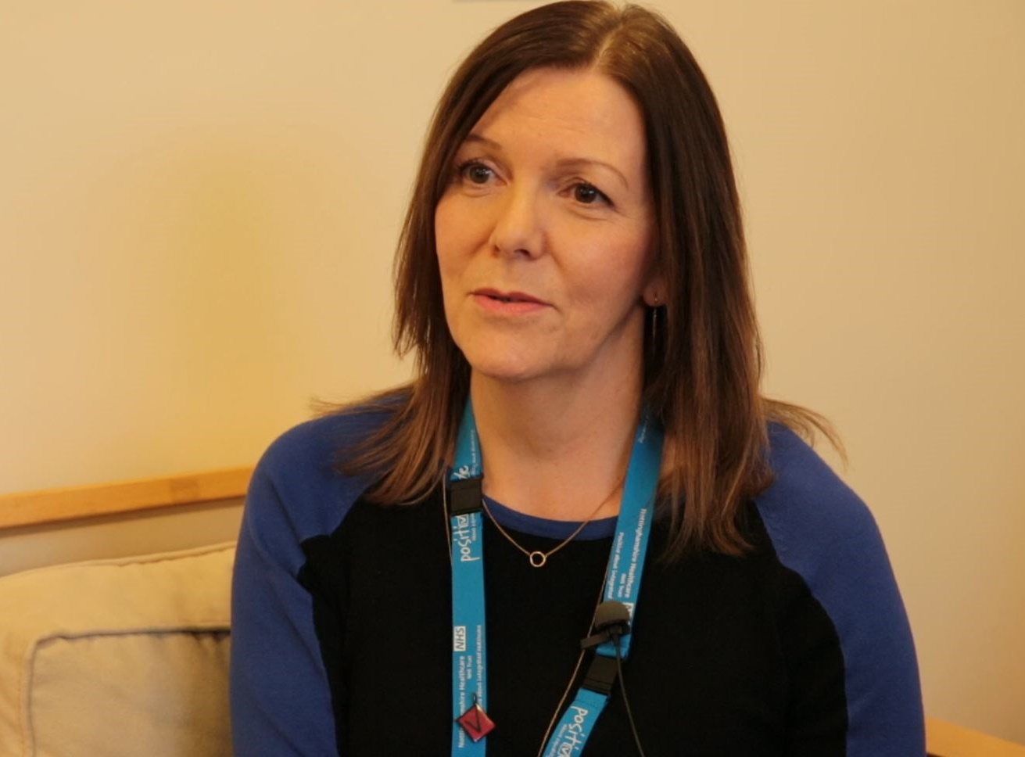
“I think Patient Opinion has given us much more of a connection with service users, carers and families and that’s because we can actually work directly with people.”
Jane Danforth involvement officer

Slide 9
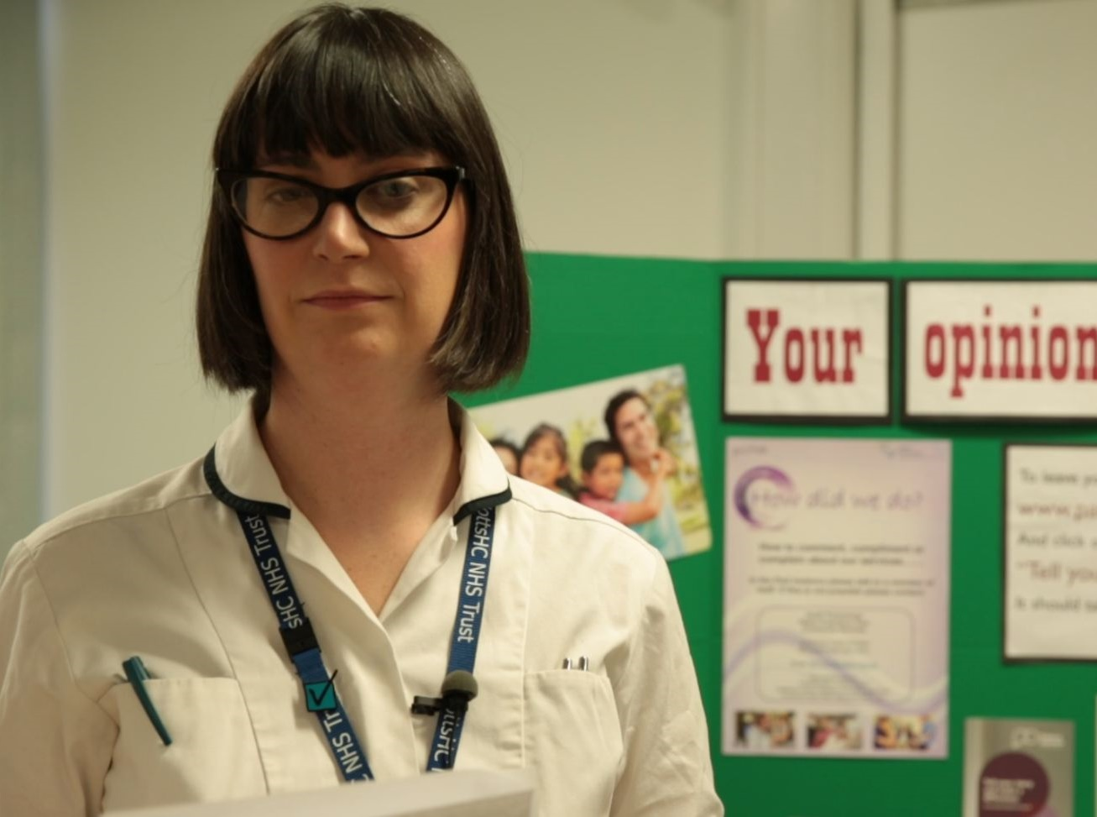
“More than just listening, it has helped us to focus on what we can change to improve our service.
We’ve learnt that Patient Opinion gives patients a powerful voice, which in turn has empowered us.”
Lisa Metcalf podiatrist

Slide 10
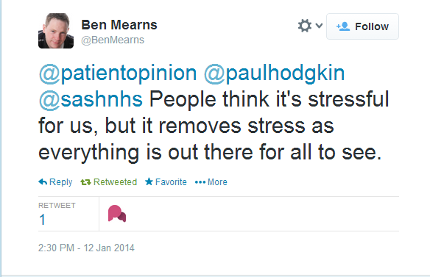

Slide 12
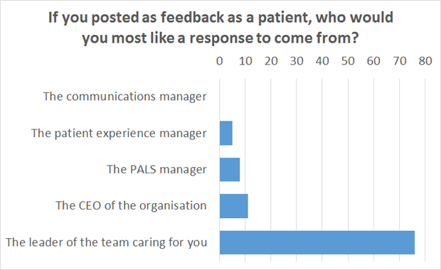

Slide 13
For services

Slide 14
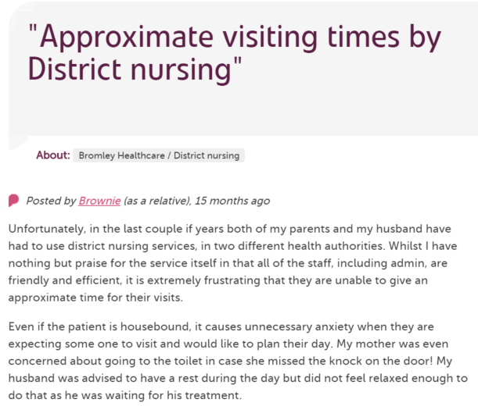
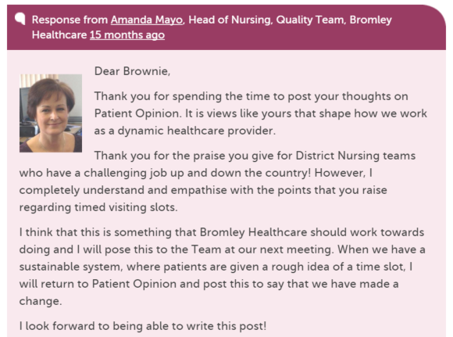
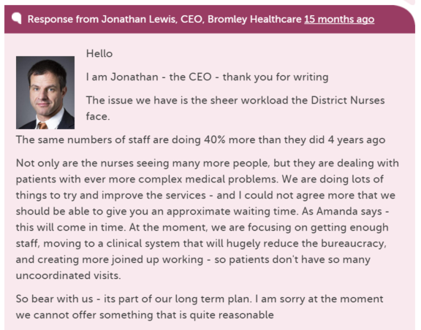
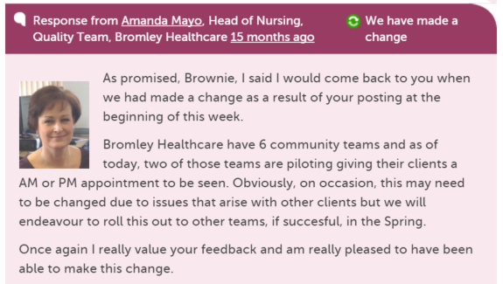
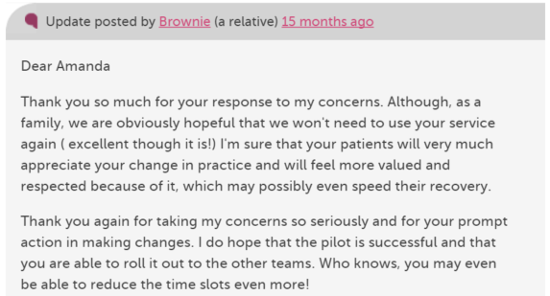

Slide 15
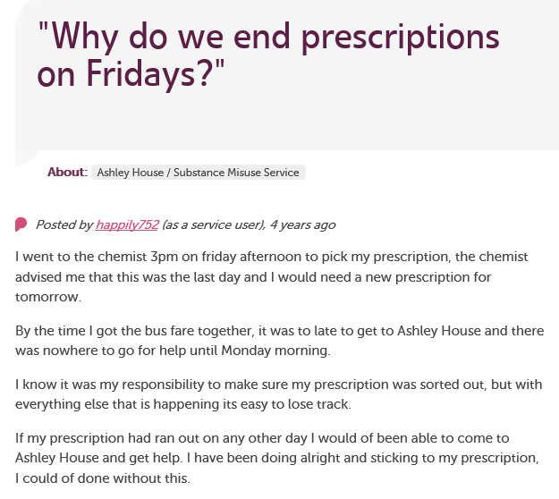
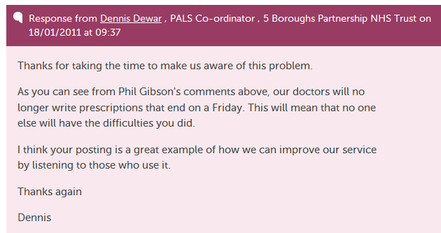

Slide 16
For organisations

Slide 17
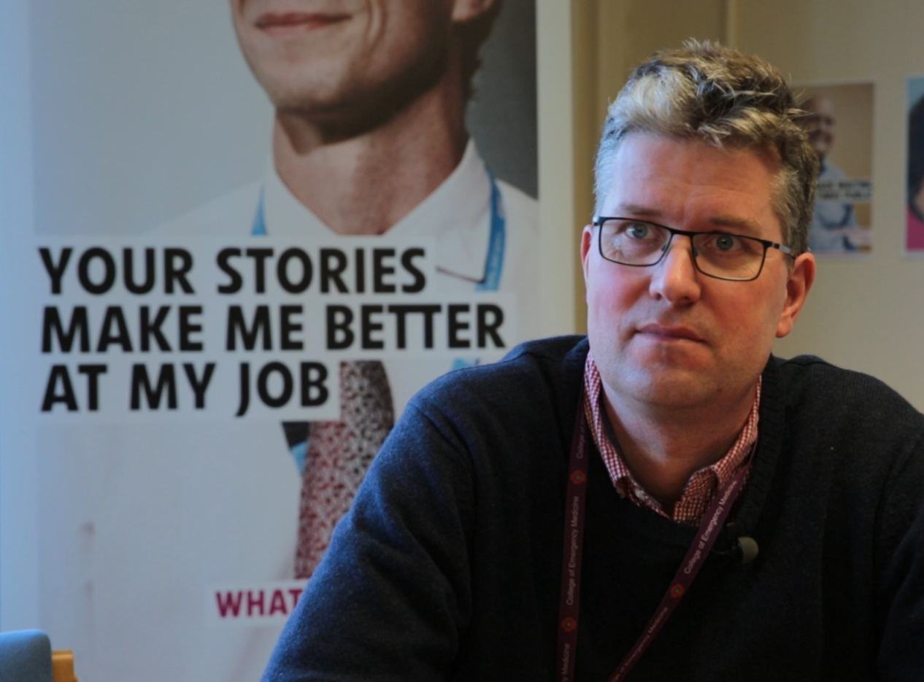
“At times it also helps to actually reduce complaints. We can get in touch with a user straight away and we can avoid a lengthy complaint response.”
Dr Arne Rose, consultant in emergency medicine

Slide 18
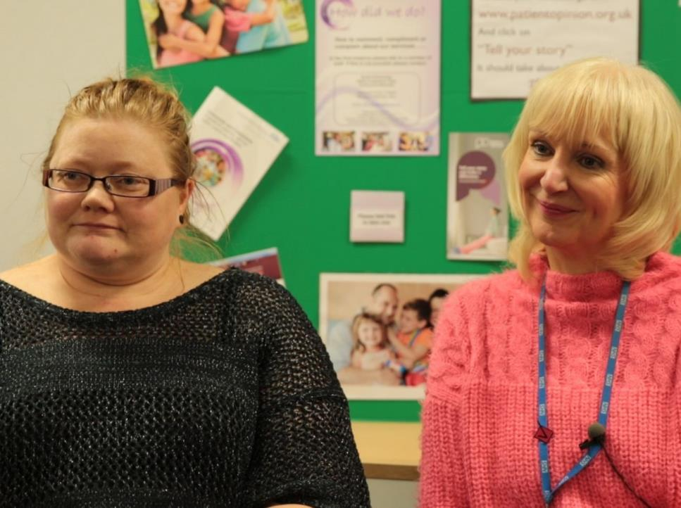
“As we’ve been on a journey, so have the users and carers been on a journey. They now have trust in us, to know that we do want to hear it, warts and all, and that we will work on what the issue is.”
Jenny Newman and Sue Dyke, public engagement

Slide 19
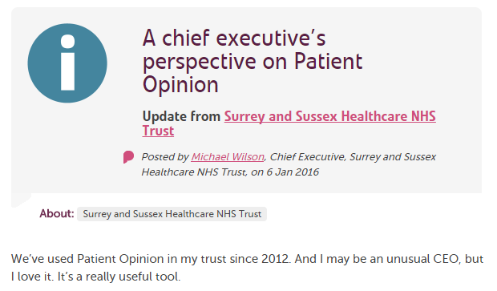

Slide 20
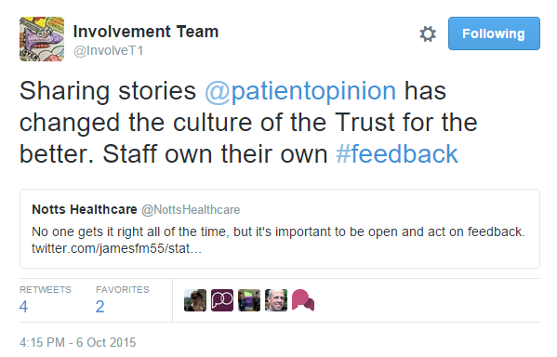

Slide 21
For education

Slide 22
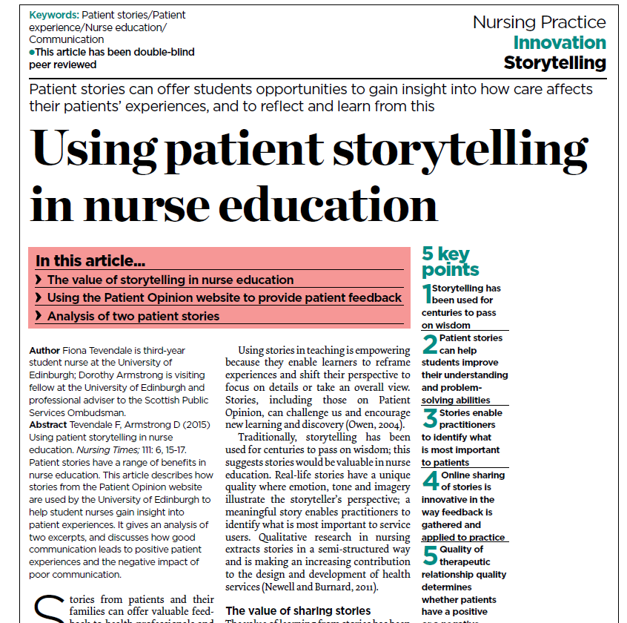

Slide 23
Learning from stories
Places the person at the centre | [Roberts 2000]
Adds richer learning and understanding | [Rugggles 2002, Charon 2009]
Engenders empathy | [Fairbairn 2002, Hardy 2007]
Encourages reflection | [Hardy 2008]
Shares perspective | [Reissman 2000]
Promotes resilience | [East et al 2010]

Slide 24
“We’re often told the NHS must be patient-centred.
Patient Opinion helps us understand what that means in practice.”
Fiona Tevendale
Student nurse
Edinburgh

Slide 25
For research

Slide 26
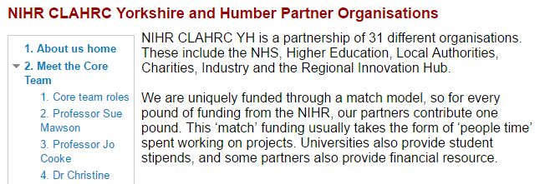
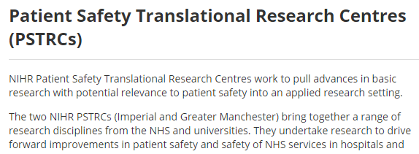

Slide 27
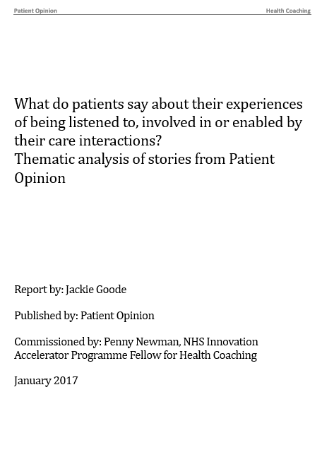
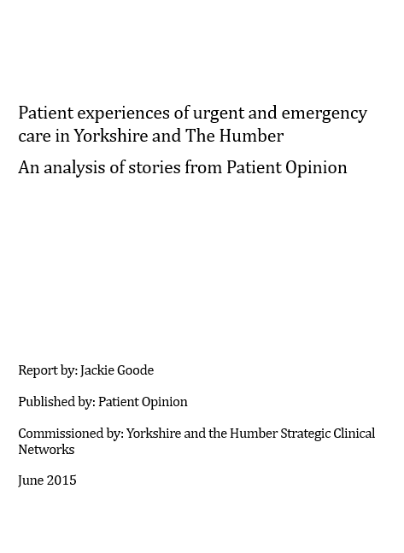
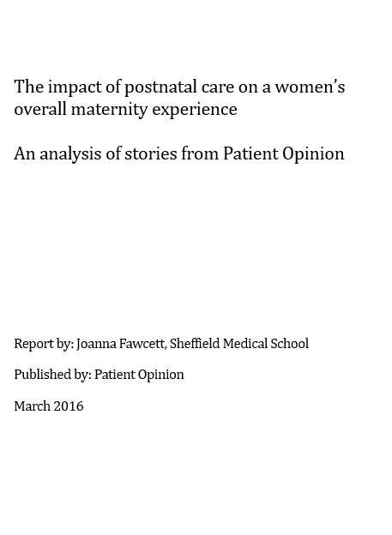
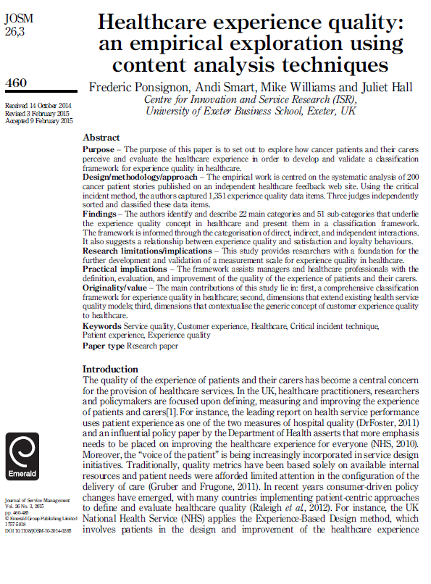

Slide 28
For the health system

Slide 29
Berwick on Mid Staffs
“Warning signals abounded and were not heeded…
Especially costly was the muffling of the voices of patients and carers who took the trouble to complain but whose complaints were too often ignored.”

Slide 30
Berwick Report, August 2013
“Hear the patient voice at every level – even when that voice is a whisper”

Slide 31
