Slide 1
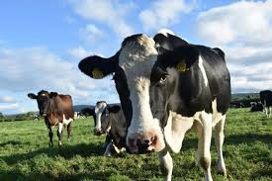
Care Opinion – A Somerset story
Hayley Hughes
Associate Director of Patient Centred Care

Slide 3
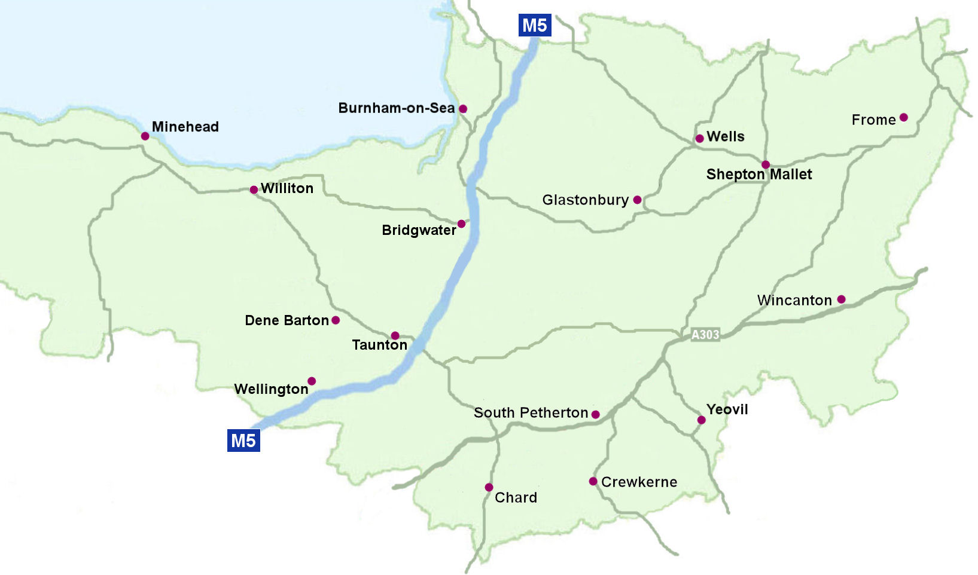
About us:
Burnham-on-Sea
Minehead
Frome
Shepton Mallet
Williton
West Mendip
Bridgwater
Dene Barton
Wincanton
Wellington
555,000 population
South Petherton
Chard
Crewkerne
District Hospitals

Slide 4
About us:
Two large NHS Foundation Trusts
9,000 staff
Income of c. £350 million
Acute, community, mental health and learning disability services
1 acute (district) hospital
13 community hospitals
9 mental health inpatient wards
100+ different services
1,000 inpatient beds
1,000 admissions to mental health wards per year
100,000 MIU attendances per year
41,000 patient admitted as emergencies each year
315,000 attend outpatient clinics
3,400 babies born in our maternity unit
Burnham-on-Sea
Minehead
Frome
Shepton Mallet
Williton
West Mendip
Bridgwater
Dene Barton
Wincanton
Wellington
555,000 population
South Petherton
Chard
Crewkerne
District Hospitals

Slide 5
The atmosphere
Recruitment and retention challenges
Working as a whole system to address challenges
Pressures on local authority services
Maintaining performance
Notes:
Recruitment and retention
Staffing levels in our community hospitals
Working as a whole system to address challenges
From competition to collaboration
Continual change > increasing demand
Pressures on local authority services
Maintaining performance: - increasing demand vs. not-so-increasing finances

Slide 6
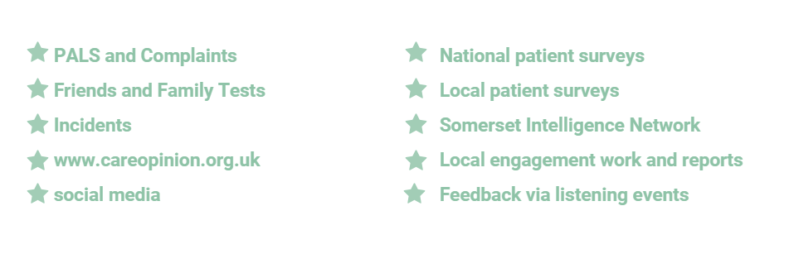
Sources of patient feedback
7,000 pieces of patient feedback a month
Notes:
Put your hand up if you have used the NHS….
-- if you have left feedback through any of these mechanisms
-- was it honest feedback?

Slide 7
Our Journey with Care Opinion from September 2016

Slide 8
Musgrove Park Hospital
69 responders
854 Stories
Stories read 259,000 times
97% responsive

Slide 9
Somerset Partnership
20 responders
666 stories
Stories read 134,000 times
100% responsive

Slide 10
Our Care Opinion

Slide 11
Widespread team feedback

Slide 13
Individual feedback

Slide 14
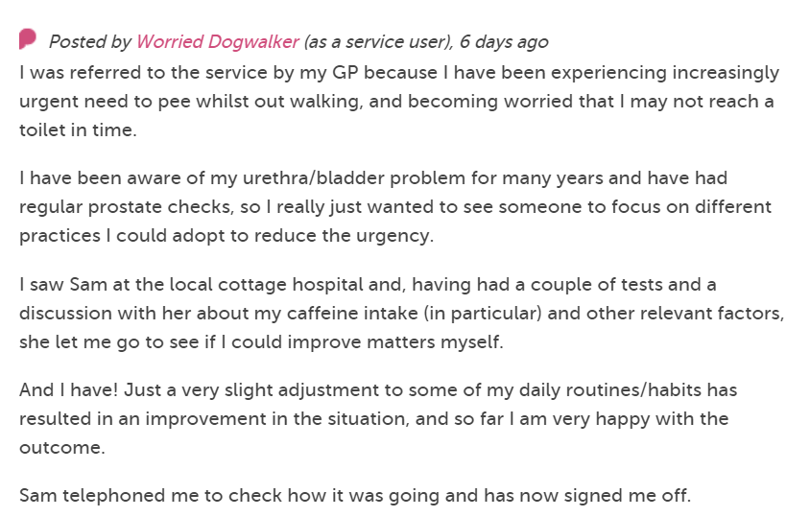
Influencing service development
Notes:
We have subscribed to CO since September 2016 and we have been invited to share our journey, the ups and downs, and our learning. Invited a couple of colleagues to help me with this.
Lucky to have senior support for our use of CO from the outset. Our Chief Exec and Communication lead gifted Care Opinion to Patient Experience team to implement.
Value of that support cannot be underestimated as when raising awareness chief exec there ‘Trip Advisor for hospital’. Took a real interest in stories posted and supported the buzz and conversation around CO.
Communications support: training responders, social media and links on Trusts internet home page.
Using tried and tested methodology we agreed to start small and build. So our initial roll out was in 4 areas: maternity, ED, Cardiology and Out-patients.
We now have ………. Responders at Musgrove Park and ……….at Somerset Partnership

Slide 15
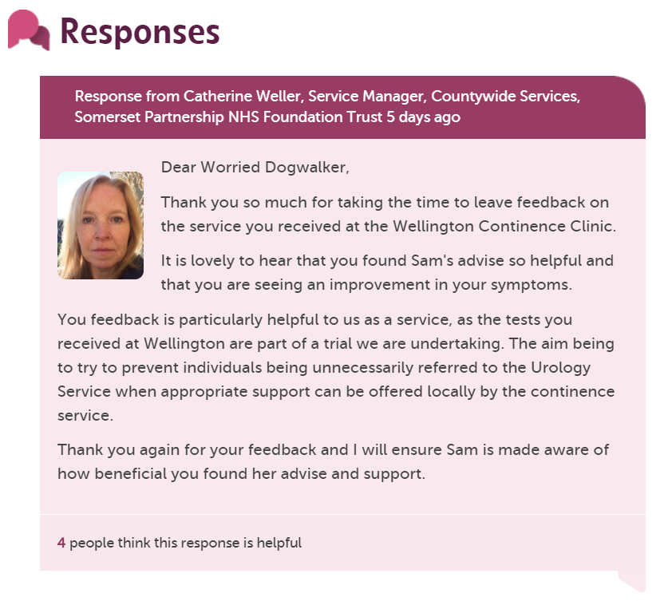
Notes:
Start with the compliments as we get a lot of praise and thanks
We love that the patients post them and those directly affected receive them but within a really wide public arena
As our executive team relieve the post in their inboxes there is real visibility of that story and we also tweet them out giving even wider views
Here's an example

Slide 16
Ongoing support
Notes:
Patients sometimes need additional help and support

Slide 18
Responding to concerns

Slide 20
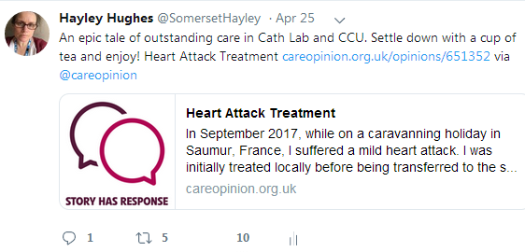
Notes:
Spreading the word

Slide 21
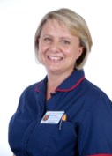
Hayley Peters, Chief Nurse
“Care Opinion has the power to truly transform how we listen to patients…It can act as a significant lever in affirming the values and behaviours that we expect from our teams.
We must empower and trust our frontline teams to respond and in doing that they engage fully and own the feedback.
Having that platform of overwhelmingly positive feedback allows our team to embrace the arena of negative feedback, which is rare, and they connect with it fully and learn what they can do to improve. For me that’s authentic.
Dealing with it publically demonstrates our transparency and commitment to listening to and learning from feedback.”

Slide 22
“Did I make a difference?”
PALS/Complaints responses to patient/carer
Posters on wards
Contact with patients if possible
Use of outcomes posts ‘we’ve made a change’

Slide 23
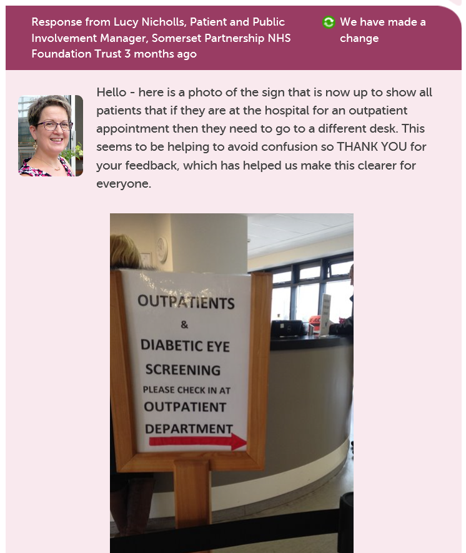

Slide 24
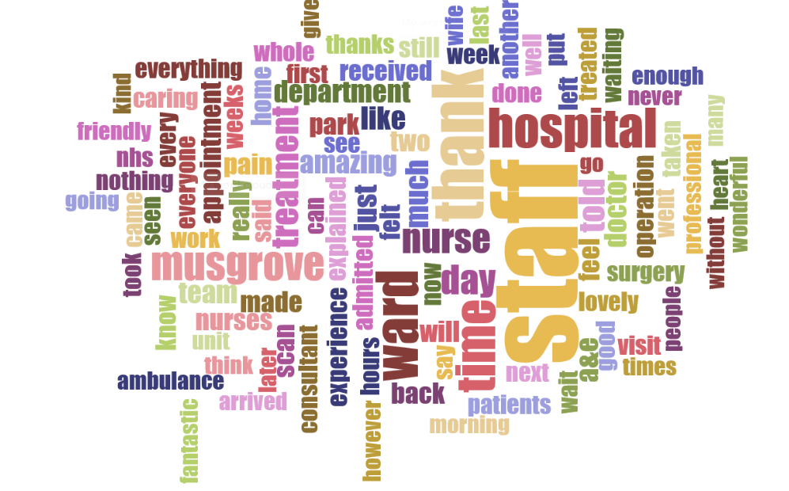
Info – how we use the tools

Slide 25
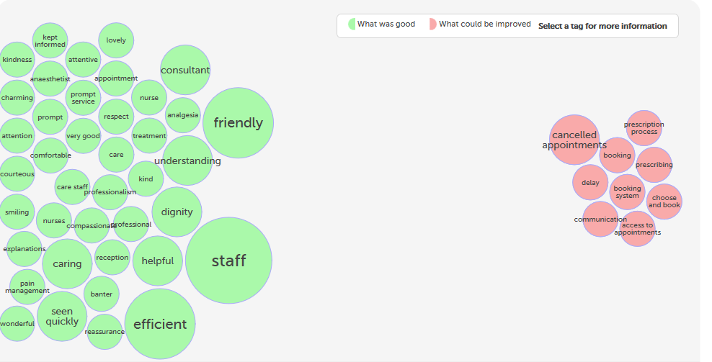

Slide 26
Next Steps
Spread the word.
Merged Trust.
Increase use of Care Opinion feedback to inform Improvement and change.
Support Responders to be creative
More responders at the frontline

Slide 27
Thank you!
Hayley Hughes
Associate Director of Patient Centred Care

