Slide 1
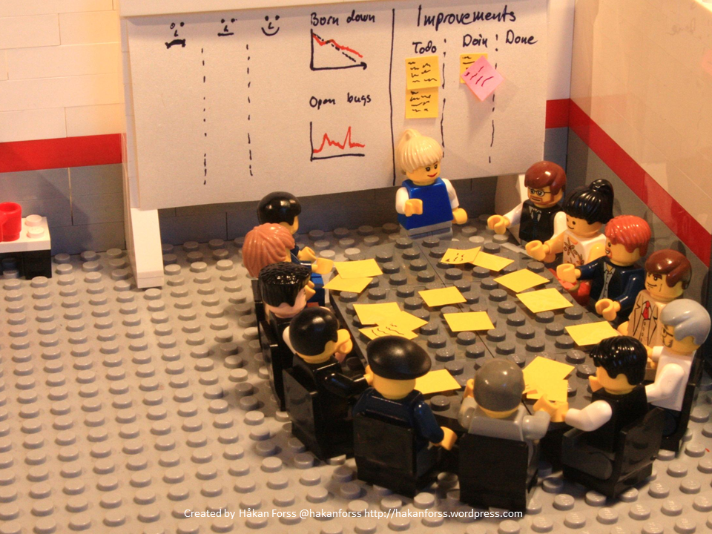
Online feedback in Primary Care Experience from East London
Caroline Millar
Lay Board Member
City and Hackney GP Confederation

Slide 2
City and Hackney GP Confederation – purpose
To support member GP practices to improve quality, resilience and stability in primary care and to develop innovative, cost-effective services that respond to the needs of local people.

Slide 3
City and Hackney GP Confederation – who we are
A social enterprise (CIC) since 2014 not NHS
43 practices/321k patients – universal coverage
Practices pay £1 per patient membership fee
14 CCG contracts worth £14m (from 2019, a single 7 year contract)
1 contract for local authority

Slide 4
City and Hackney GP Confederation – what we do
Delivering extended contracts
Service redesign and quality improvement
Workforce development
Spearheading the ‘GP at scale’ model nationally
Developing neighbourhood model of service delivery
Research and innovation

Slide 5
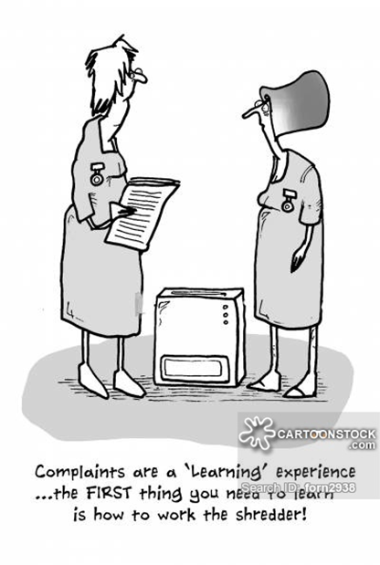
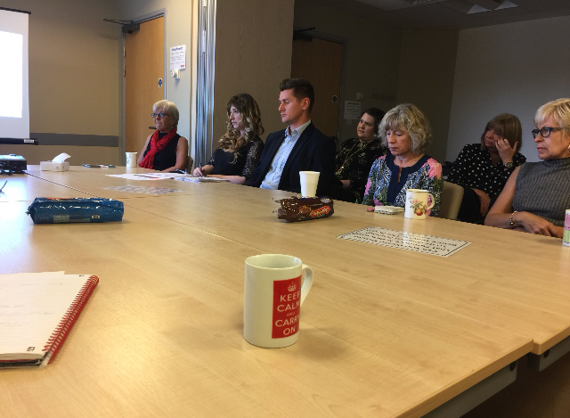
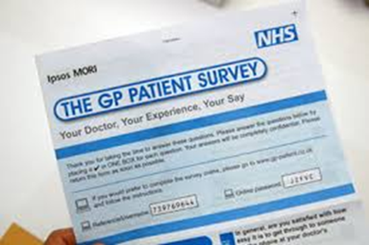
Why we wanted to change the way we did patient feedback

Slide 6
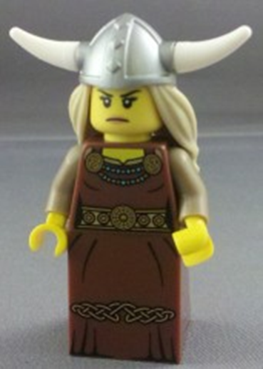
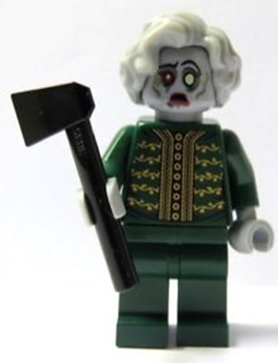
How practices feel about their patients

Slide 7
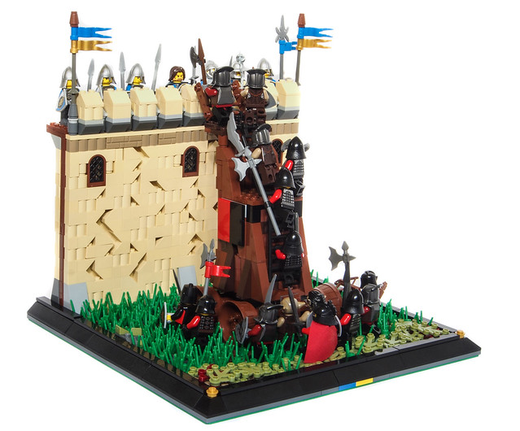
Introducing Care Opinion: June AD 2018

Slide 8
Initial concerns in practices
No time or energy to take on something new
Anxiety about staff being identified
Perceived imbalance of power between patient and responder
Will just increase complaints and damage staff morale
What’s wrong with NHS Choices?
CQC looks at Choices star ratings

Slide 9
Care Opinion in GP practices in C&H – the pilot
Free to practices (fees paid by Confed)
Initial 6 months - extended to one year
11/42 practices volunteered for pilot
Senior leadership (Confed Board, GP leaders, Practice Managers’ Forum) on board
Significant support from Care Opinion: on call, webinars, email updates and encouragement
CO tools: widgets on the website, cards, posters, screen images etc
Regular reporting from CO to practices and Confederation

Slide 10
Feedback from practices after ten months
Surprised at positivity of feedback – completely different to NHS Choices
Very easy to use – notified of stories – easy to respond
Practices creating incentives for staff to encourage stories
Stories being read out at practice meetings
Keen to use with PPGs
Overall, clinicians promote CO less than reception staff
Excellent support and responsiveness from Care Opinion
Range of different people responding (receptionists, GPs, nurses). More staff being trained up.

Slide 11
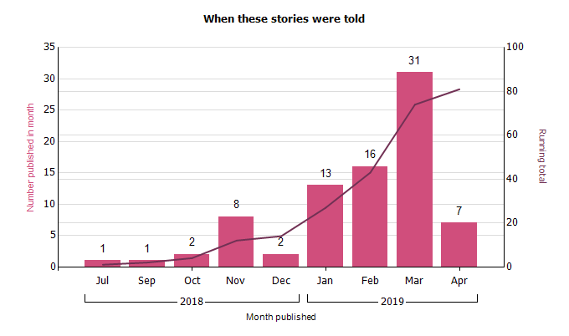
Slow but steady increase in stories

Slide 12
Where we are now (June 2018 to April 2019)
Practice | Total stories | Responsiveness | Changes | Care Opinion | NHS UK
A | 20 | 100% (20) | 0 | 20 | 0
B | 5 | 80% (5) | 0 | 0 | 5
C | 8 | 100% (8) | 1 | 0 | 8
D | 5 | 100% (5) | 0 | 1 | 4
E | 32 | 67% (22) | 0 | 15 | 17
F | 13 | 100% (13) | 0 | 7 | 6
G | 5 | 60% (3) | 0 | 2 | 3
H | 112 | 73% (99) | 0 | 22 | 90
I | 35 | 86% (30) | 1 | 12 | 23
J | 8 | 100% (9) | 1 | 3 | 5
81 stories viewed 1,438 times

Slide 13
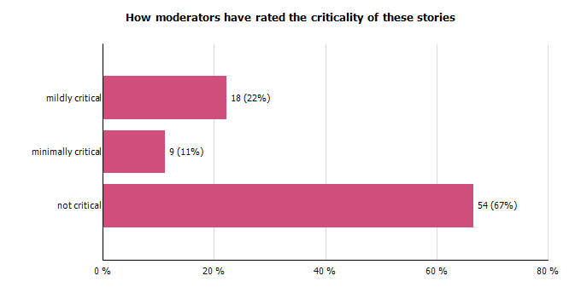
Criticality of the stories

Slide 14
What’s good
Service
Staff
Helpful
Receptionist
Efficient
Care
Friendly
Kind
Professional
Caring
Polite

Slide 15
What needs improvement
Booking systems
Access to appointments
Attitude
Communication
Information given
Keep informed
Receptionist
Website

Slide 16
Feelings
Thank you!
Happy
Pleased/very pleased
Grateful
Amazing
Reassured
Relieved
Valued
Well treated
Frustrated
67% no criticism at all

Slide 17
C&H GP practice initiatives
Cranwich Road Surgery 2nd GP practice in UK to have Care Opinion screen saver

Slide 18
Where we are now
Much less negativity about the idea from practices
All practices want to continue using Care Opinion
Number of stories increasing every month
Just starting to see some evidence of changes being made in response to feedback
Still some frustration that so few patients are using it
Link being sent with appointment follow-up texts

Slide 19
Next steps
Give Patient Participation Groups access to Care Opinion and reports (as part of new PPG pilot)
Build CO into new models of patient engagement across the new neighbourhoods/networks
Raise awareness of CO across Hackney
Allow others to respond to stories – PPGs, Confed, CCG?
Share data with other providers and patient groups?
Persuade other healthcare providers to join us by signing up – a single route for all feedback on health in H&C?
Confederation staff support for practices using CO?
Monitor progress and impact (survey of pilot practices)

Slide 20
Any questions?
Caroline Millar
City and Hackney GP Confederation
caroline.millar3@nhs.net

