Slide 1
180,000
stories
7,000
staff + students listening
stories read
85 million
times
100,000
visitors per week

Slide 2
Lots of activity. But for what benefit?

Slide 3
For authors

Slide 4
Thank you
“I’ve always believed in the NHS… I know it’s people doing their job, but the way they do it makes all the difference in the world.
Thanks to Care Opinion too for creating the opportunity for me to say thank you.”
https://www.careopinion.org.uk/opinions/269312

Slide 5
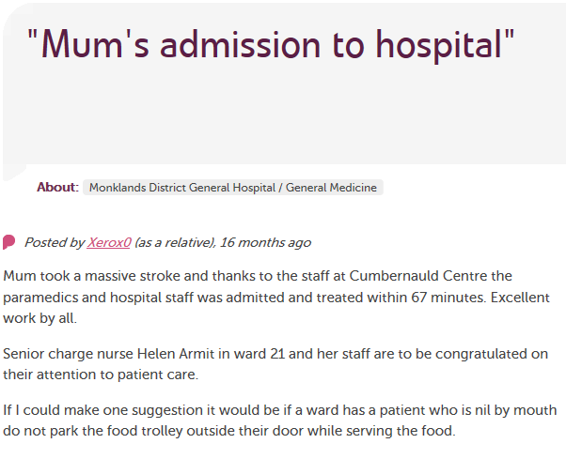
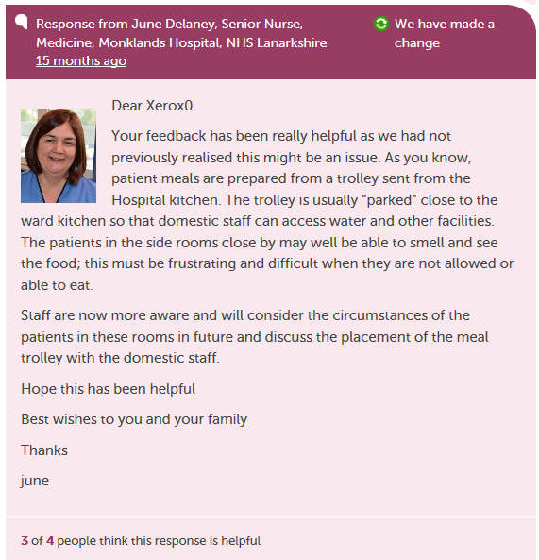

Slide 6
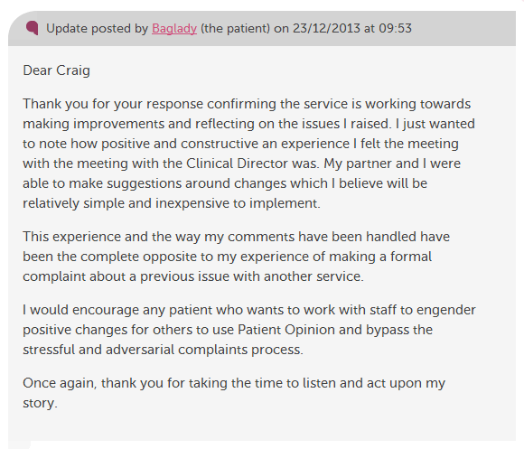

Slide 7
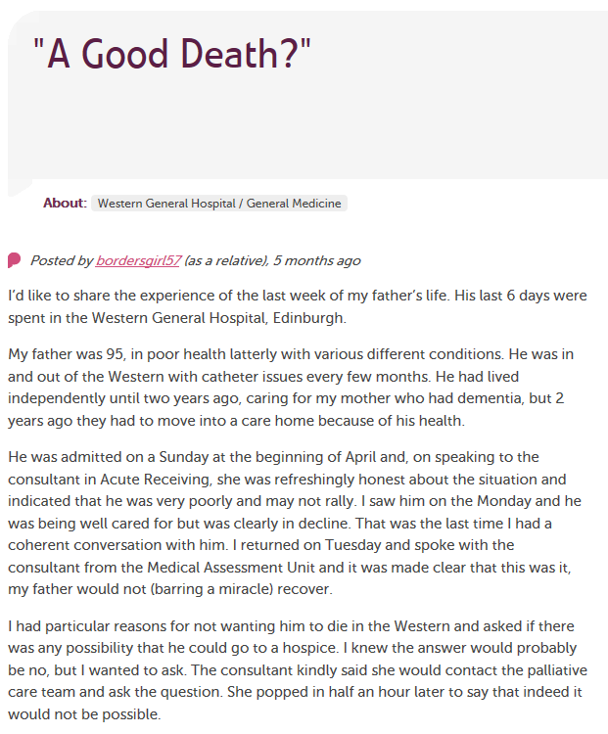
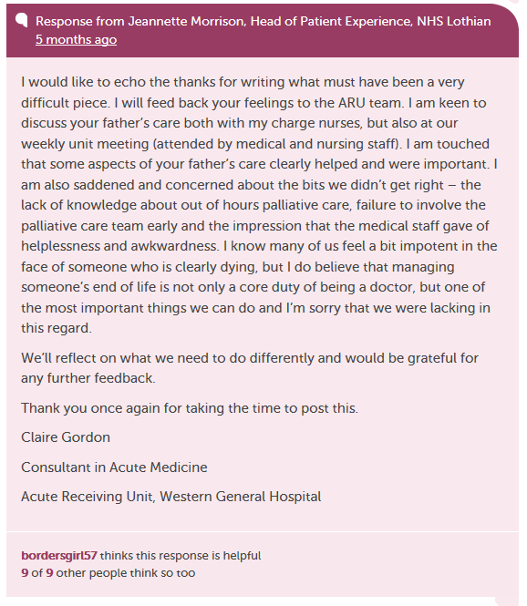
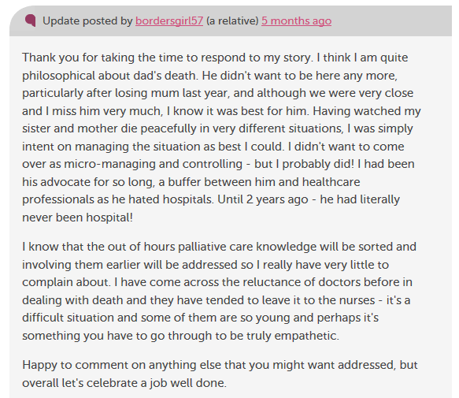

Slide 8
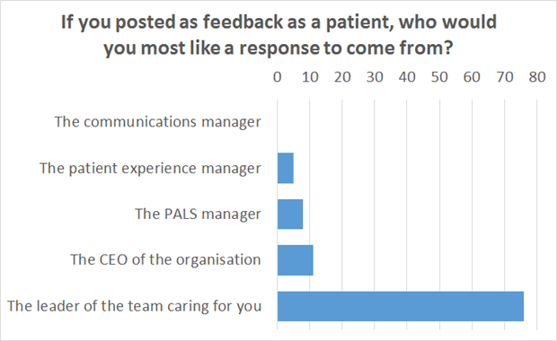

Slide 9
For services

Slide 10
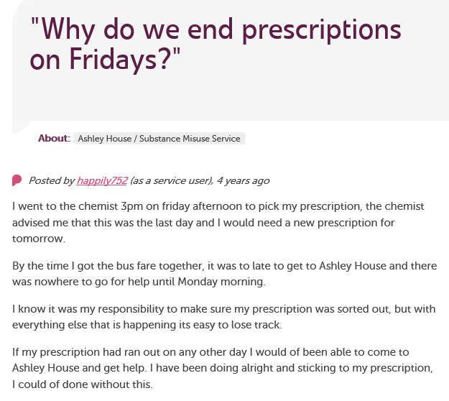
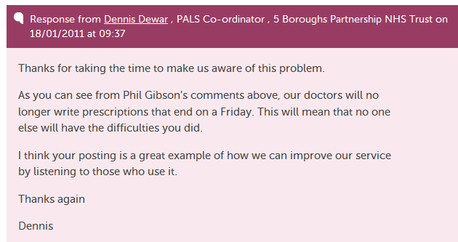

Slide 11
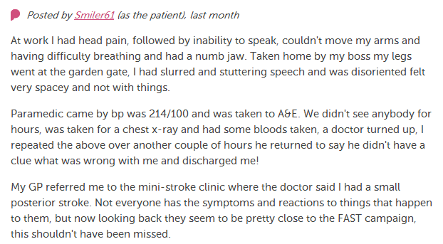
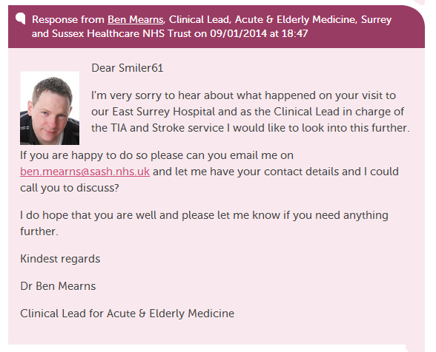
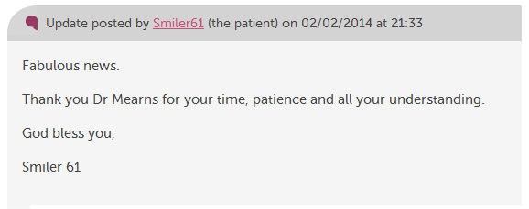

Slide 12
For staff

Slide 13
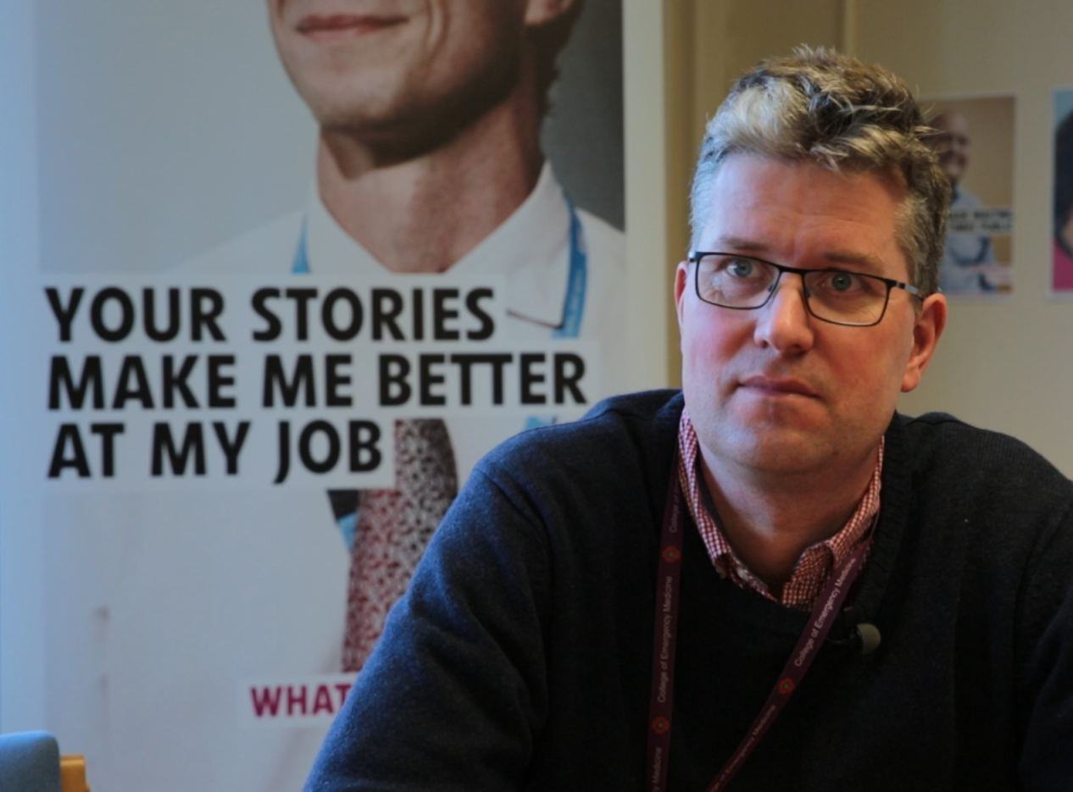
“At times it also helps to actually reduce complaints. We can get in touch with a user straight away and we can avoid a lengthy complaint response.”
Dr Arne Rose, consultant in emergency medicine

Slide 14
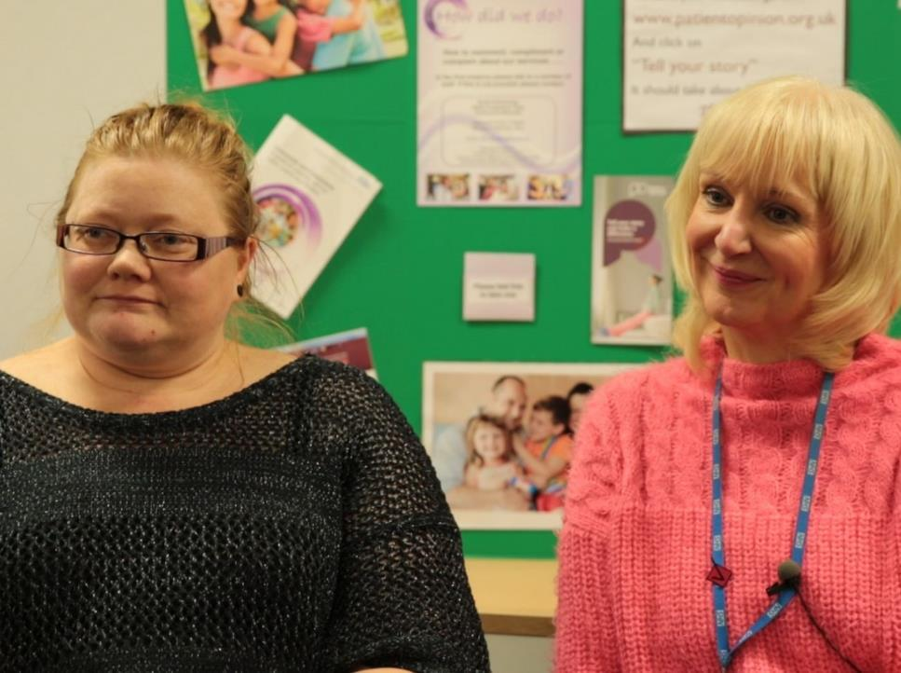
“As we’ve been on a journey, so have the users and carers been on a journey. They now have trust in us, to know that we do want to hear it, warts and all, and that we will work on what the issue is.”
Jenny Newman and Sue Dyke, public engagement

Slide 15
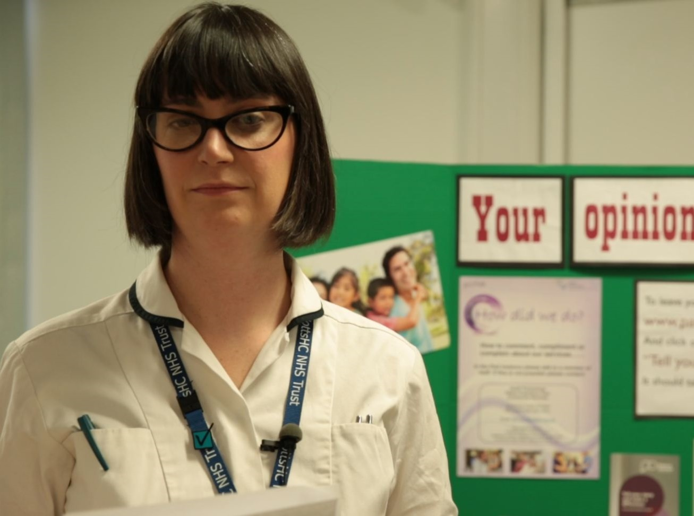
“More than just listening, it has helped us to focus on what we can change to improve our service.
We’ve learnt that Patient Opinion gives patients a powerful voice, which in turn has empowered us.”
Lisa Metcalf podiatrist

Slide 17
Learning from stories
Places the person at the centre | [Roberts 2000]
Adds richer learning and understanding | [Rugggles 2002, Charon 2009]
Engenders empathy | [Fairbairn 2002, Hardy 2007]
Encourages reflection | [Hardy 2008]
Shares perspective | [Reissman 2000]
Promotes resilience | [East et al 2010]

Slide 18
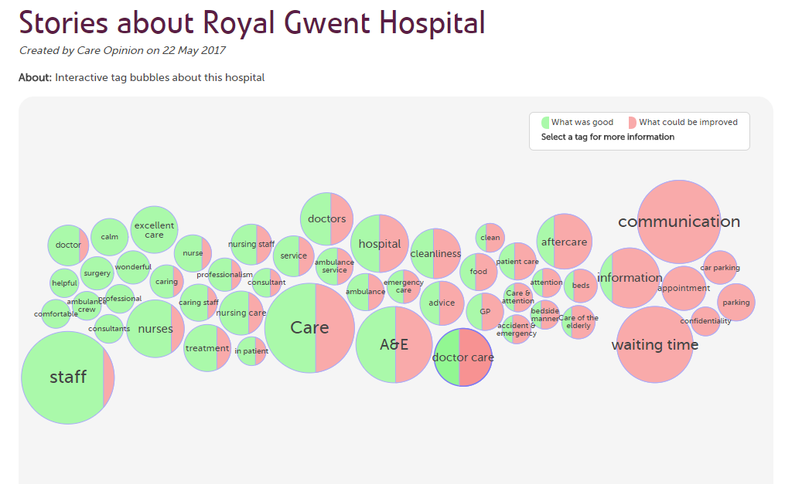
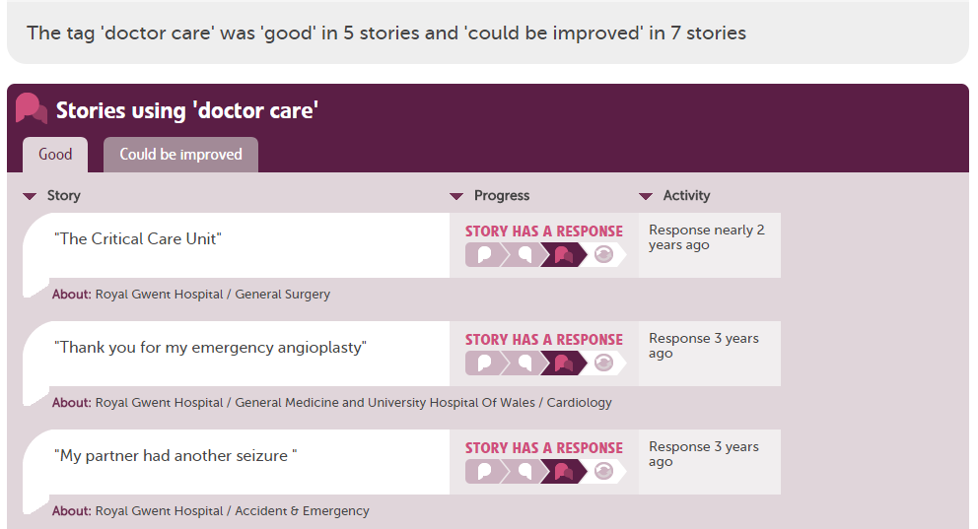

Slide 19
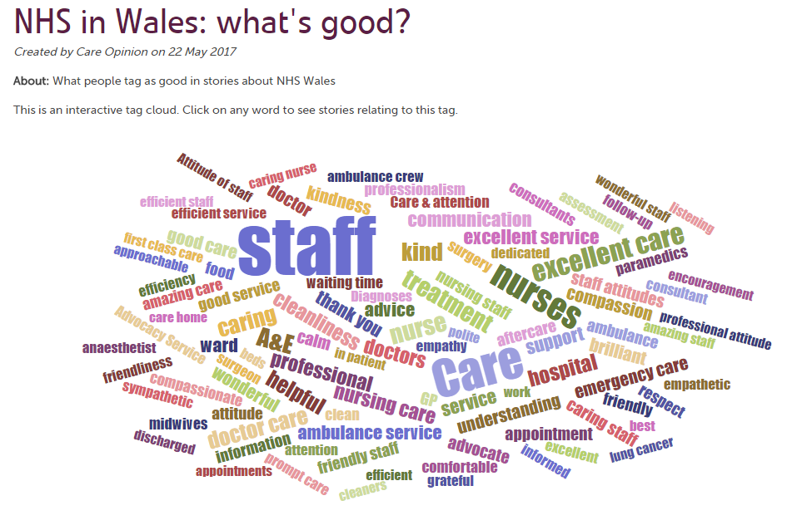

Slide 20
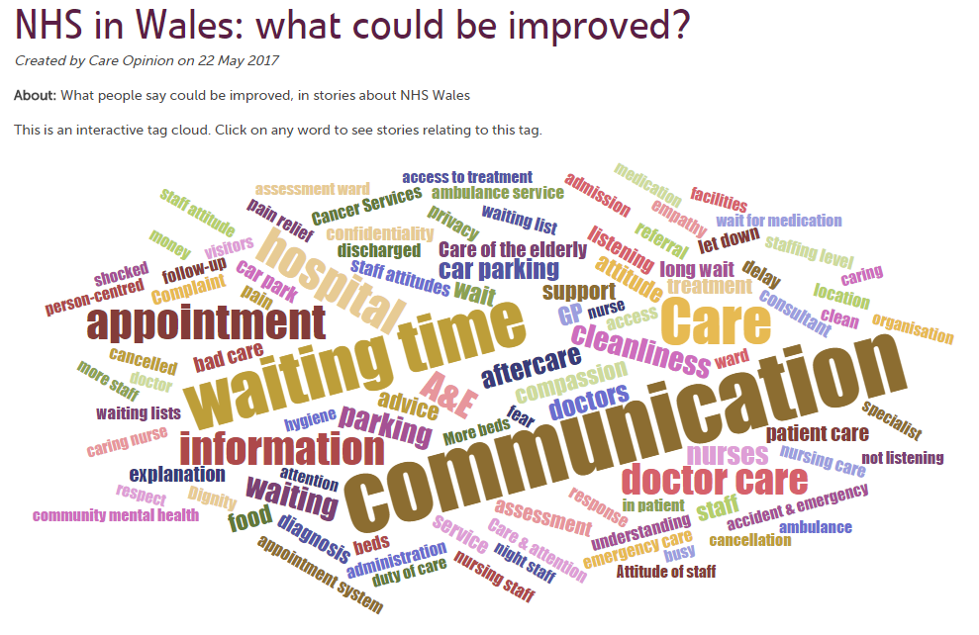

Slide 21
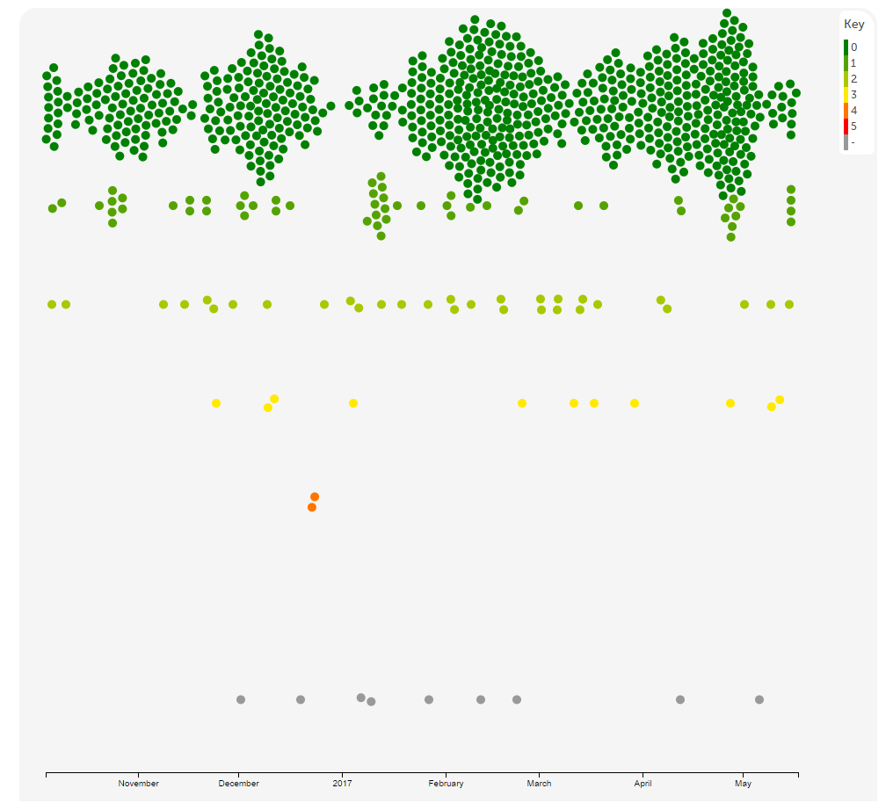

Slide 22
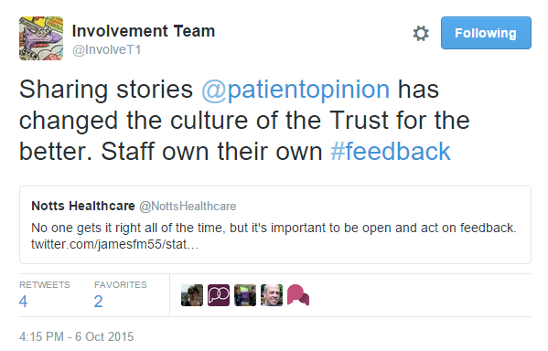

Slide 23
The world is changing – fast
Old world | New world
Hierarchy | Network
Broadcast | Conversation
Hiding | Sharing
Few | Many
Closed | Open
Passive recipients | Active participants

Slide 24
Berwick Report, August 2013
“Hear the patient voice at every level – even when that voice is a whisper”

