Slide 1
Context, mission and service
James Munro, CEO, Care Opinion CIC

Slide 2
Vision
We want people to be able to share their experiences of health and care in ways which are safe, simple, and lead to learning and change.

Slide 3
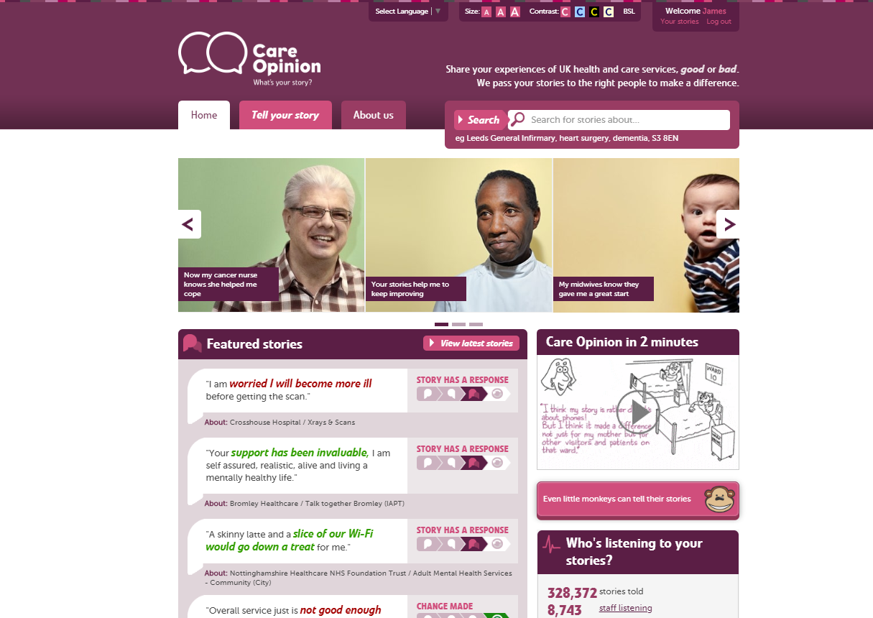

Slide 4
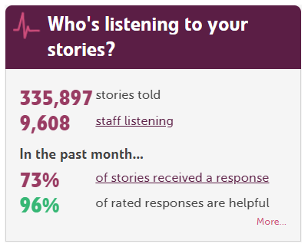

Slide 5
350,000
stories
9,600
staff + students listening
stories read
95 million
times
100,000
visitors per week

Slide 6
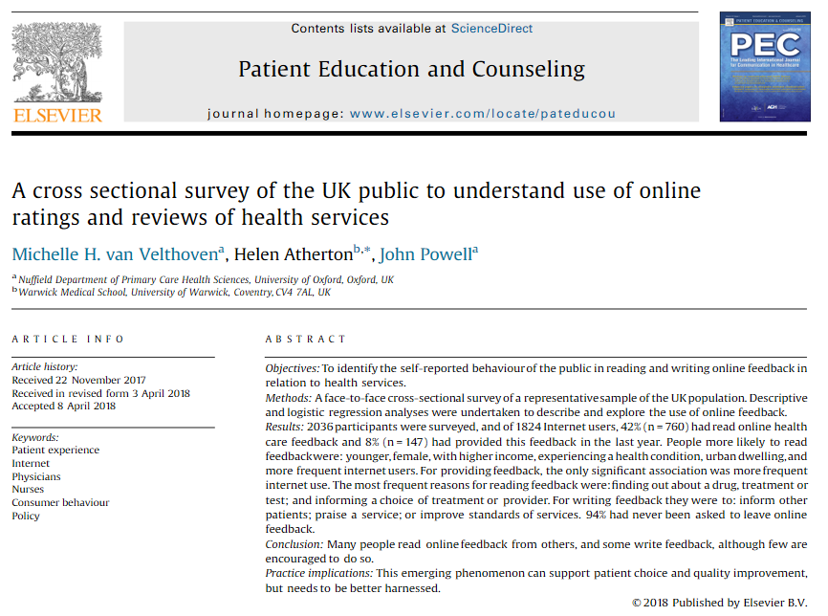
In the past year, 42% of people have read online feedback about healthcare

Slide 7
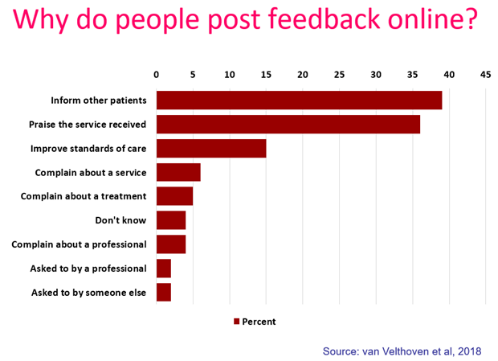

Slide 8
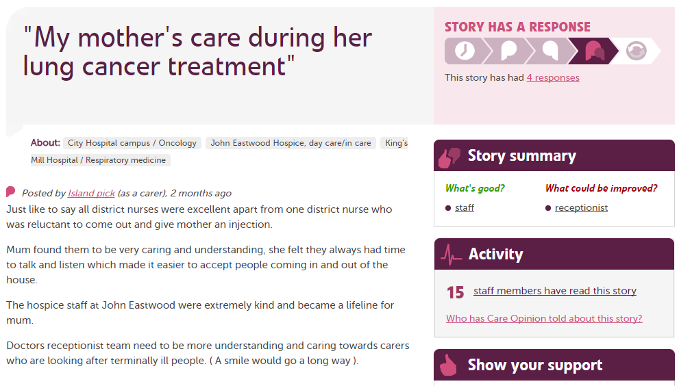

Slide 9
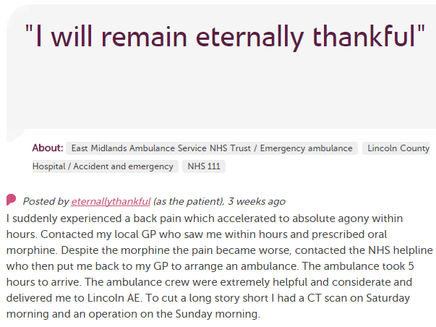
In each provider
Moderation
Clinical staff
Porters, reception, catering…
Pt exp, comms, complaints…
Alerting
CEO
Commissioners
Nursing, AHP students
Healthwatch
Researchers
Patient groups
CQC
Local authority

Slide 10
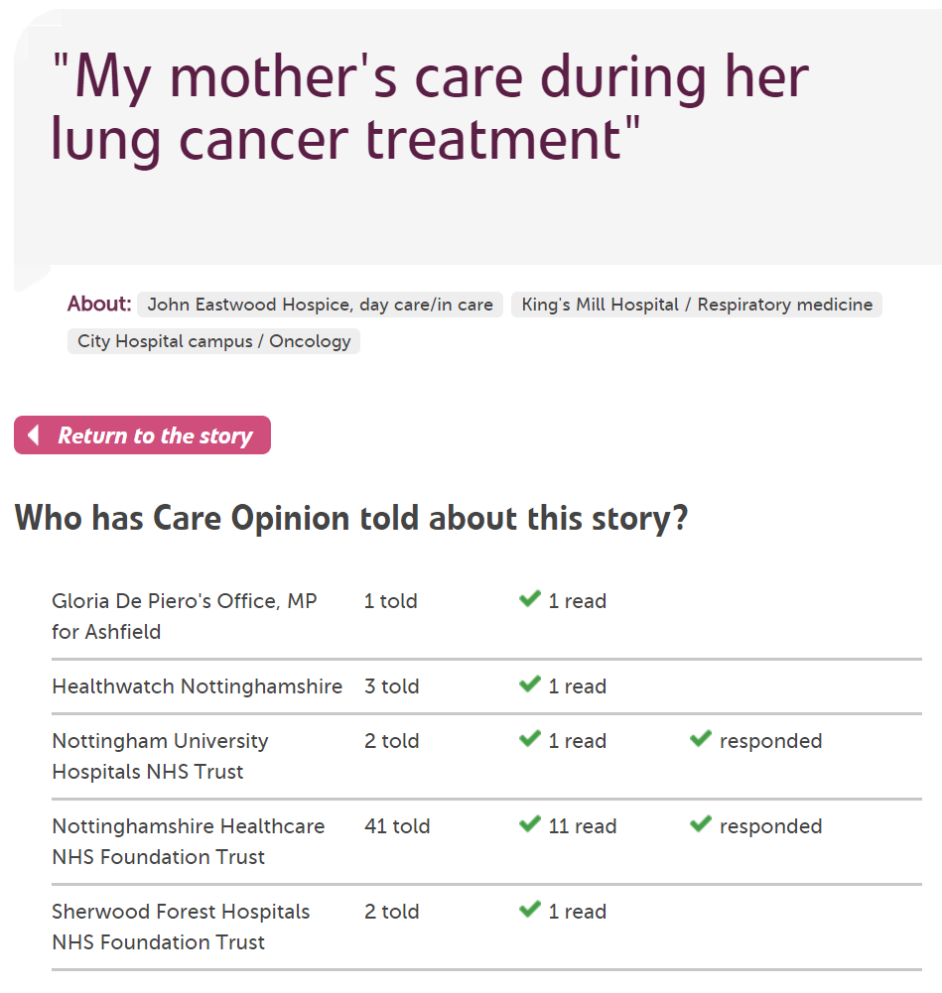

Slide 11
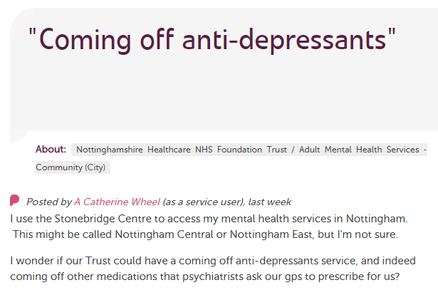
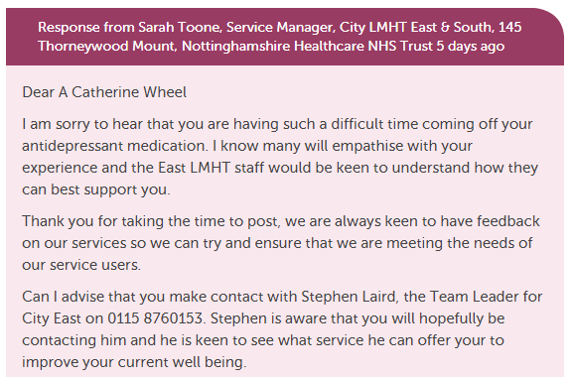
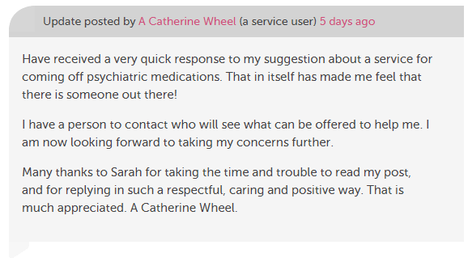

Slide 12
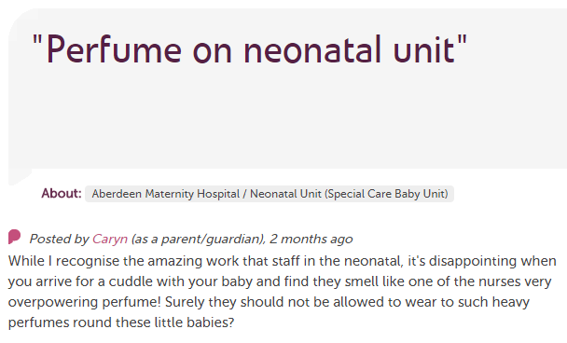
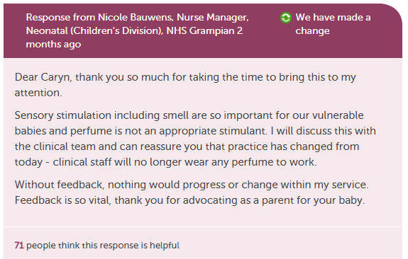
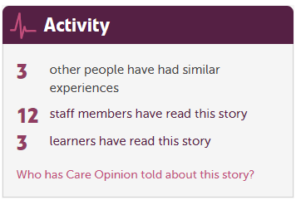

Slide 13
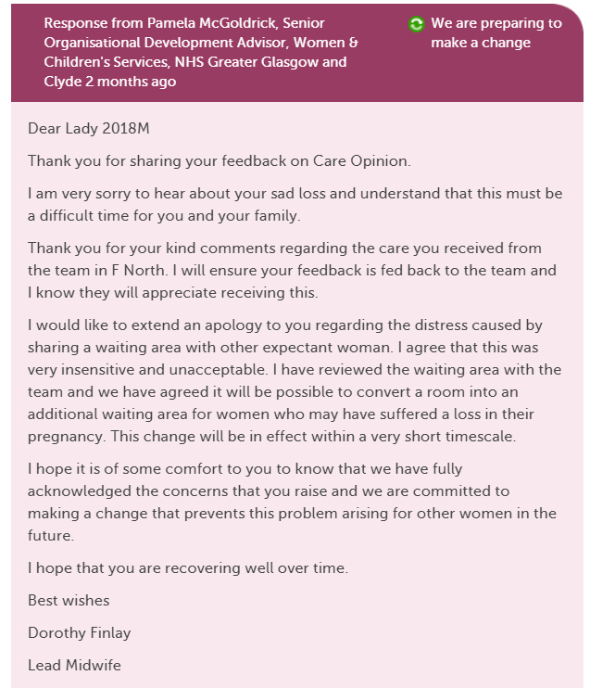
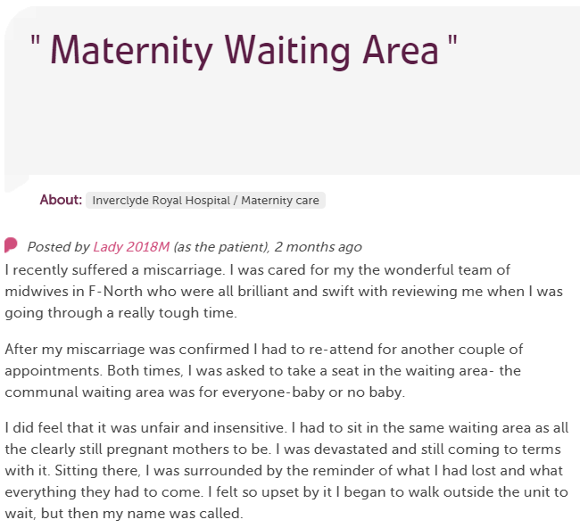
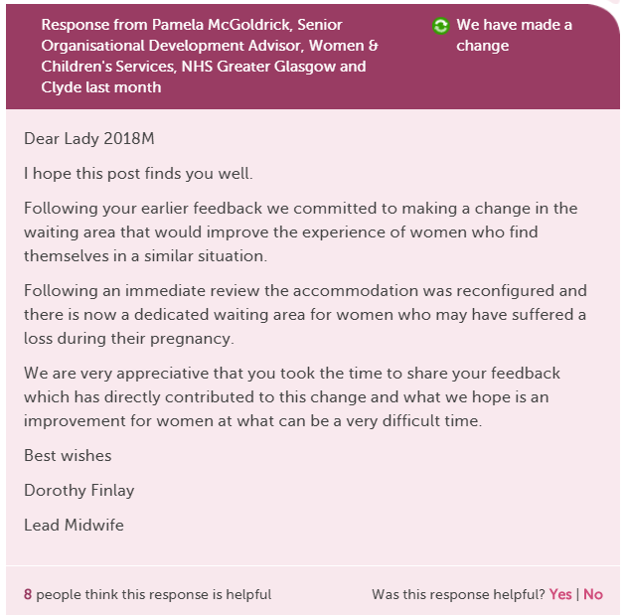
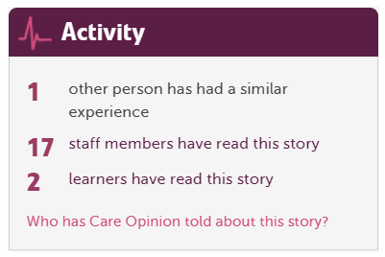

Slide 14
“It was therapeutic in healing my soul.”

Slide 15
“It was a difficult time for me to go through and Care Opinion allowed me to control the speed and words rather than be rushed through Q&As or tick box scenario where things don't quite fit.”

Slide 16
“The fact I did not have to give my name made it a lot easier to provide feedback. I find it hard to do it in person.
I would like it to make changes.”

Slide 17
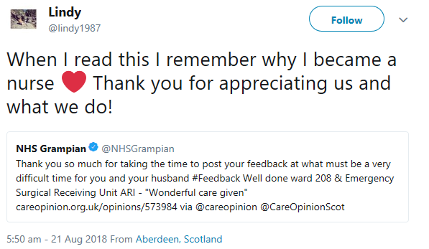

Slide 18
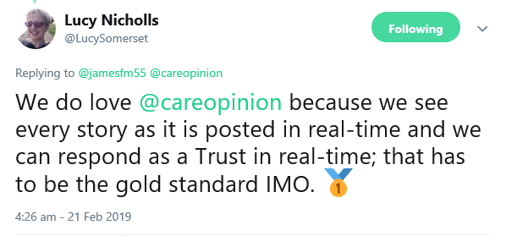

Slide 20
Hear the patient voice at every level – even when that voice is a whisper.
Don Berwick
August 2013

