Slide 1
Care Opinion: Thinking big about online feedback
Perspective from a Commissioner
1st May 2019
Created by:
Alex Ward- Booth

Slide 2
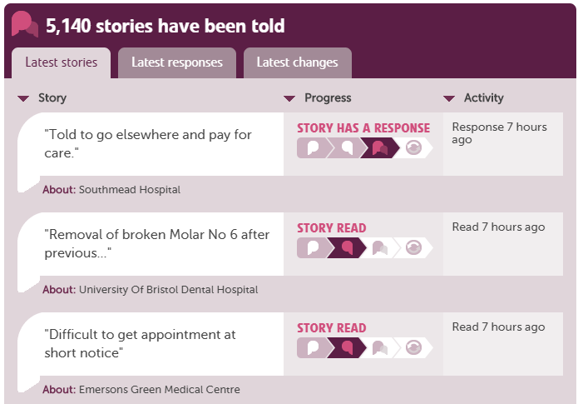
Overview
Context
Perspective
Next
Notes:
Set the scene for this session – will talk about our context – the jumping fish become a bit of a symbol for what we’re trying to do as an organisation and as a team. We are looking to establish ourselves in a new context and challenge our current thinking
Will also give our perspective around online feedback and what we’ve done so far
Also think about the future and where we see this developing

Slide 3
Some context about our team
Operational
Transformation
Communications and Engagement
System Partners
Insight and Engagement
Commissioning Teams
Project Teams
Quality, BI, etc. etc.
Notes:
We sit within the transformation team and whilst our primary target is about driving insight-led communications from the CCG, as a new team we need to reach out to form networks across the CCG, but also outside the CCG with our network

Slide 4
Our Strategy on a Page
Understanding the needs of those outside the organisation to drive better decision accuracy, pace and better health outcomes
Setting the context
Defining the Strategy
Influencing the Culture
Ensuring we learn from our key projects to drive future activity (e.g. Healthy Weston, Community Services, Mental Health Services Strategy, Urgent Care Strategy etc.)
Horizon scanning for future trends
Ensuring that everyone sees Engagement as a key part of their role
Patient Experience
Wider and deeper analysis to deliver actionable insight

Slide 5
Improvement Assessment Framework (IAF):
Green rating overall but…clear areas for further improvement:
Clear and consistent approach to co-design
Aligning workstreams to bring together a common thread through Comms, Engagement, Equality/Diversity and Quality
Supporting staff and public alike through public engagement work
Working in partnership across our system - ensuring engagement aligned to patient experience

Slide 6
Some thoughts about Online Feedback…
Challenge has been around ensuring that we are able to derive real value from this data at a macro level
Exploring thematic analysis to drive our the overarching trends and set a framework for ongoing tracking
Also about ensuring that organisationally, we are set up to align insights from patient experience alongside our other engagement work to:
Establish where priorities need to be set
Generate ideas
Monitor performance

Slide 7
Online/Offline: Citizen’s Panel
Citizen’s Panel launched in November 2018
First wave completed – currently conducting a second wave of research
Have analysed the responses of 525 people from first wave – currently 991 on panel and growing
Mixed methodology – online and offline methods to drive accessibility and aid loyalty (online, face-to-face, post and telephone all offered)
Retention rate on the panel is currently 68%

Slide 8
Some thoughts about our partners…
Primary Care
Learn from best practice
Drive consistency
Chart showing providers:
Primary Care – learn from best practice and drive consistency
Secondary Care – ensure insights are shared and acted upon
Third sector – ensuring we do the right things, right (!)
Secondary Care
Ensure we connect with key teams
Drive insight sharing, aggregation and implications
Third Sector
Establish connection to our patients
Ensure we do the right things right!

Slide 9
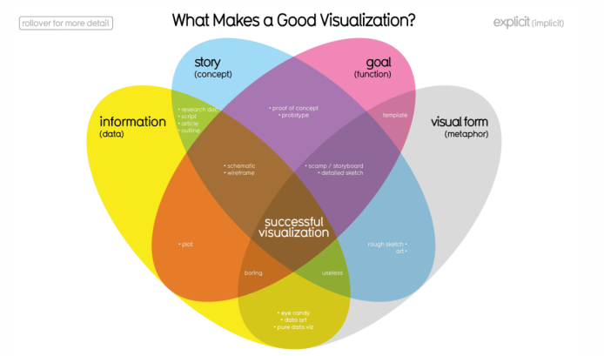
Where next?
Data Visualisation
Data management
Toolkits

